Slide 1


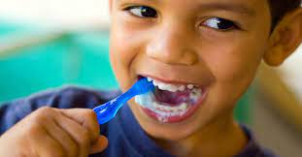
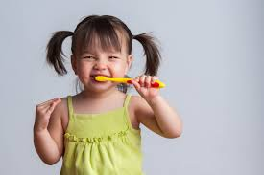
Brush-a-mania 2025
www.brushamania.ca
PowerPoint presentation prepared by Dr. Amanada Trotti

Slide 2
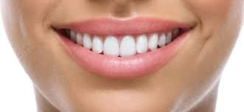
Hey everyone! I’m Dr. (insert you name here) and every year I visit schools during Oral Health Month to talk about starting up and keeping up good habits to make sure your teeth and gums stay nice and healthy!

Slide 3

Three things you can do at home to keep your smile healthy:
1) eat healthy meals and snacks
2) brush your teeth twice a day
3) Clean between your teeth with dental floss

Slide 4
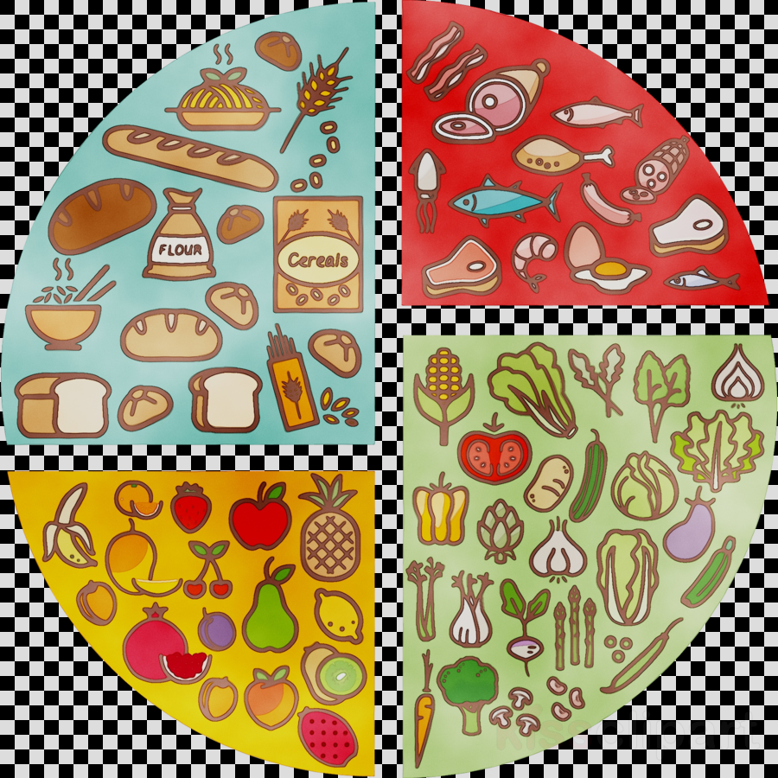
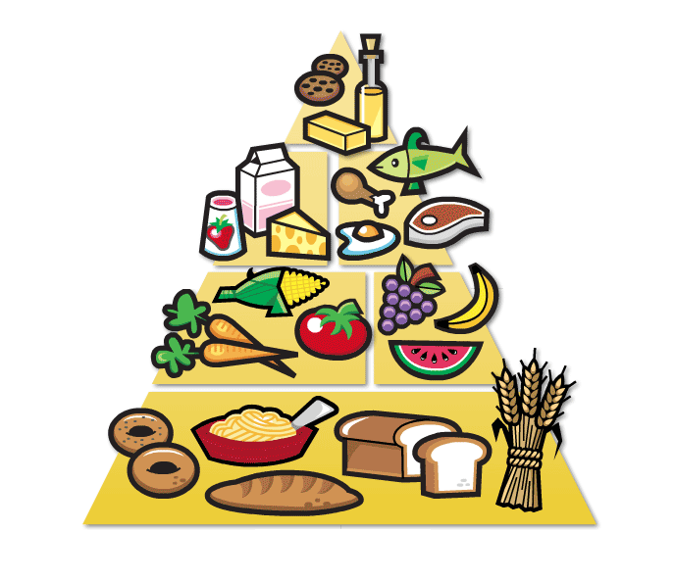
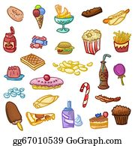
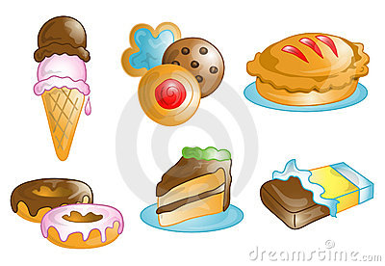
1) Eat healthy meals
These kinds of foods for breakfast, lunch and dinner are healthy, give you lots of energy, and keep your body, teeth, and gums healthy.
These kinds of foods are not very nutritious for your main meals and have a lot of sugar, which is not good for your teeth.

Slide 5




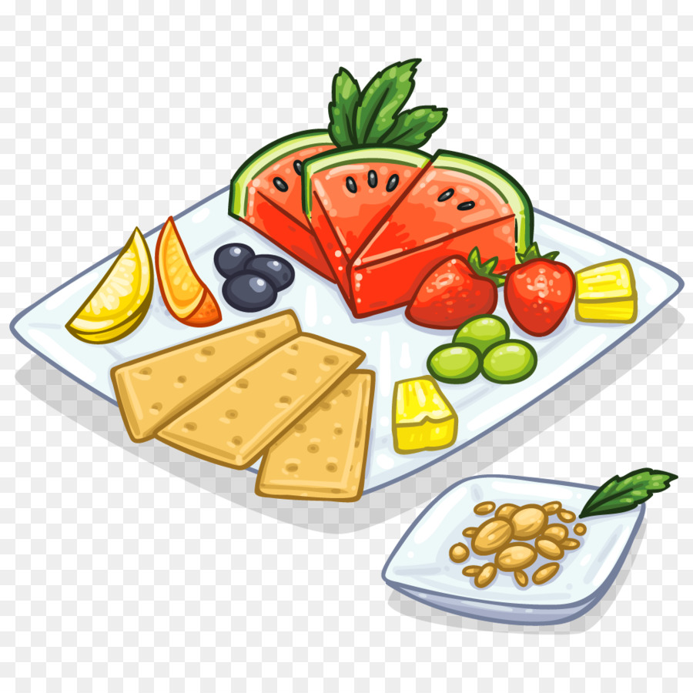


Eat healthy snacks
When you do get hungry during the day, grab something tasty that is both nutritious and good for your teeth. Some good choices are fresh fruits and vegetables, popcorn, yogurt, nuts, peanut butter, or a small piece of cheese.

Slide 6
Of course, sweets are OK as a “Sometimes Treat”!
Just as long as you….

Slide 7
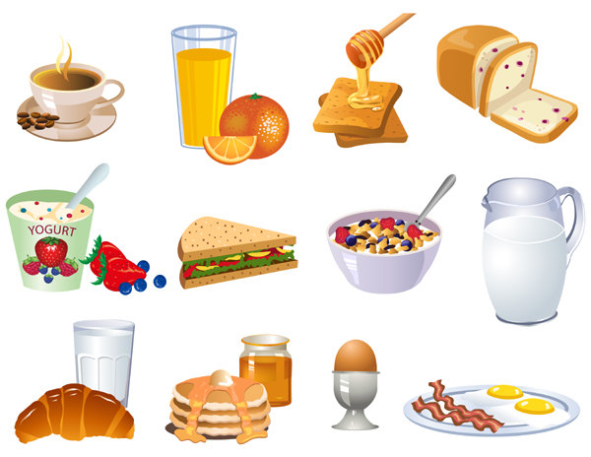

2) Floss then brush your teeth at least twice a day
After Breakfast
At Bedtime, or after dinner (This should be the last thing you do before sleeping)

Slide 8
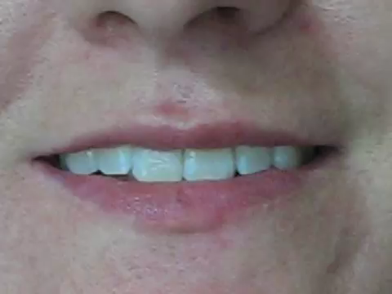
clean in between your teeth!
Use Floss! You can get mom or dad to help you if you get stuck.

Slide 9
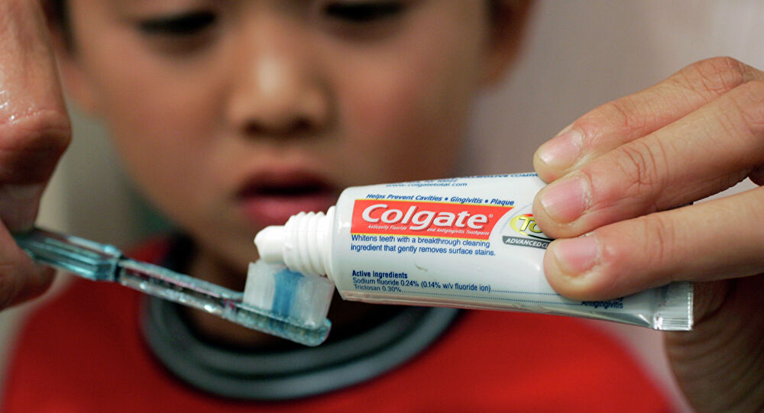
How Do I Brush My teeth?
Put a pea sized amount of toothpaste on your toothbrush
Start at the top back tooth on the one side. Place your brush at an angle along the outer gumline. Brush each tooth gently four times: Down away from the gum, in circles or wiggle back and forth. Then brush the next tooth, again gently four times.
Continue until you reach the last tooth on the other side. Then we are going to brush the inside surface of each tooth. Again start at the back top and brush all of your teeth until you reach the last tooth on the other side.
Do the same thing to the bottom teeth: Brush up away from the gum, in circles or wiggle back and forth. Then brush the chewing surface of each tooth. Use the tip of the brush to brush behind each front tooth, both top and bottom

Slide 10

Watch and Learn!!!You should spend two full minutes brushing.

Slide 11
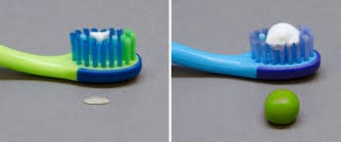
When you brush your teeth, only use a PEA-SIZED AMOUNT of toothpaste and make sure you spit it all out. You don’t have to rinse. Let it stay on your teeth for extra protection!

Slide 12
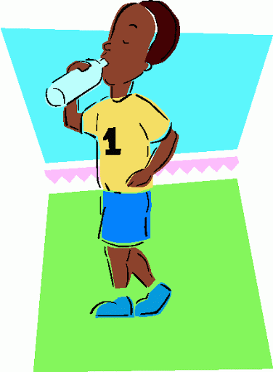
If you cannot brush after snacking, be sure to drink lots of water to flush out your mouth.

Slide 13
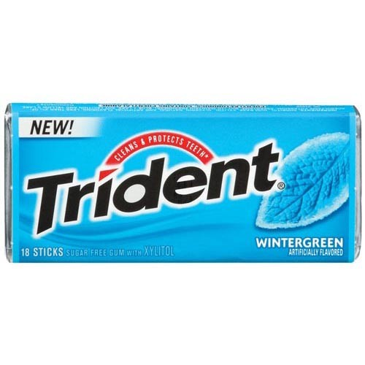
Sugarless gum is also OK to use on occasion (I like Trident because it tastes good!).

Slide 14

Thank you for watching my presentation! I can’t wait to come and visit you guys again. In the meantime, stay safe and healthy and make sure you are taking care of yourselves.

Slide 15

Cool Bonus Video!!!

Slide 16
Thank you for participating in Brush-a-mania 2025!
www.brushamania.ca

