Slide 1

Insert School Name:
Insert Date of Presentations:

Slide 2
What is Brushamania?
April is Oral Health Month, and we dentists want to come into schools to help students learn how to make healthy decisions about their teeth and mouths, and encourage them to be active participants in their oral health.
(The chance to win a Nintendo Switch is a
good boost, too!)

Slide 3
What is Oral Health?
Oral health is essential to general health and quality of life. It is a state of being free from mouth and facial pain, oral and throat cancer, oral infection and sores, periodontal (gum) disease, tooth decay, tooth loss, and other diseases and disorders that limit an individual’s capacity in biting, chewing, smiling, speaking, and psychosocial wellbeing. Risk factors for oral diseases include unhealthy diet, tobacco use, harmful alcohol use, and poor oral hygiene.
–World Health Organization

Slide 4
What are diseases of the mouth that cause pain and reduce quality of life?
Dental Decay
Gum Disease
Oral Cancer

Slide 5
What is dental decay?
CAVITIES!!!

Slide 6
CAVITIES
Cavities refer to tooth decay, which occurs when specific types of bacteria produce acid that destroys the tooth’s enamel and its underlying layer, the dentin. Symptoms include:
Toothache.
Sensitivity to sweet, hot or cold foods, or drinks.
Pain when chewing.
Cavities can be a number of different colours, from yellow to black, and they might not hurt in the beginning.

Slide 7
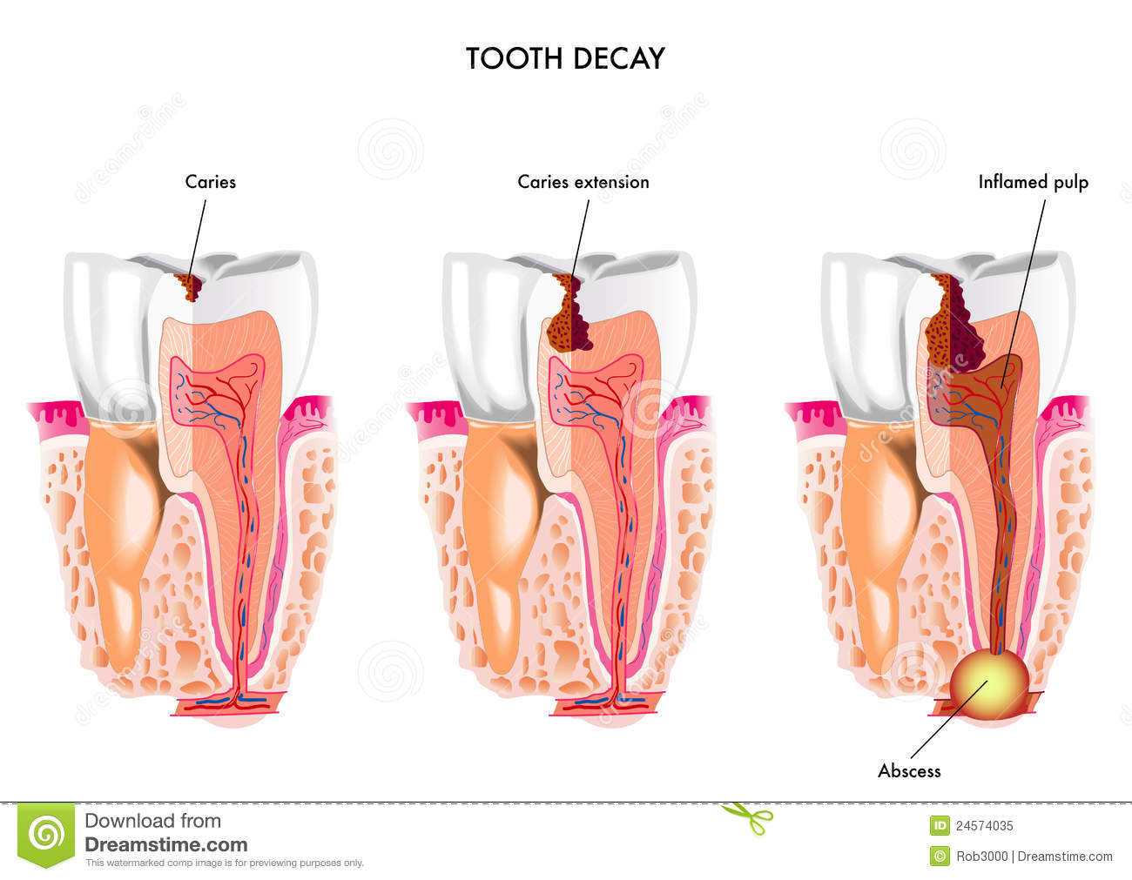
CAVITIES!!!!

Slide 8
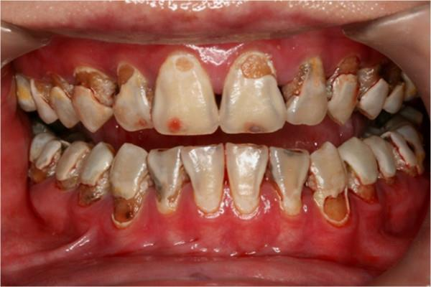
This is what dentists call “rampant decay.”

Slide 9
What causes tooth decay?
Tooth decay occurs when foods containing carbohydrates (sugars and starches), such as breads, cereals, milk, soda, fruits, cakes, or candy are left on the teeth. Bacteria that live in the mouth digest these foods, turning them into acids. The bacteria, acid, food debris, and saliva combine to form plaque, which clings to the teeth. The acids in plaque dissolve the enamel surface of the teeth, creating holes in the teeth called cavities.

Slide 10
What is plaque?
A sticky deposit on teeth which bacteria proliferate.
Sounds Awesome, right???

Slide 11
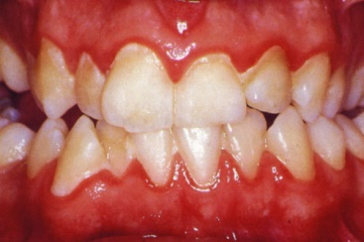
A sticky deposit on teeth which bacteria proliferate!!!

Slide 12
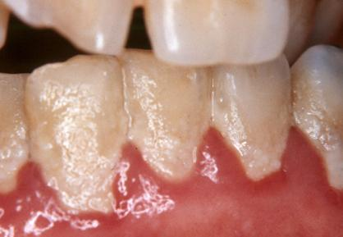
A sticky deposit on teeth which bacteria proliferate!!!

Slide 13
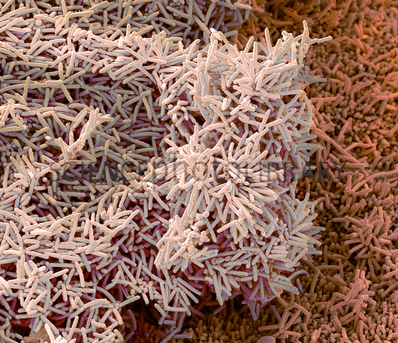
WHO ARE THESE GUYS???

Slide 14
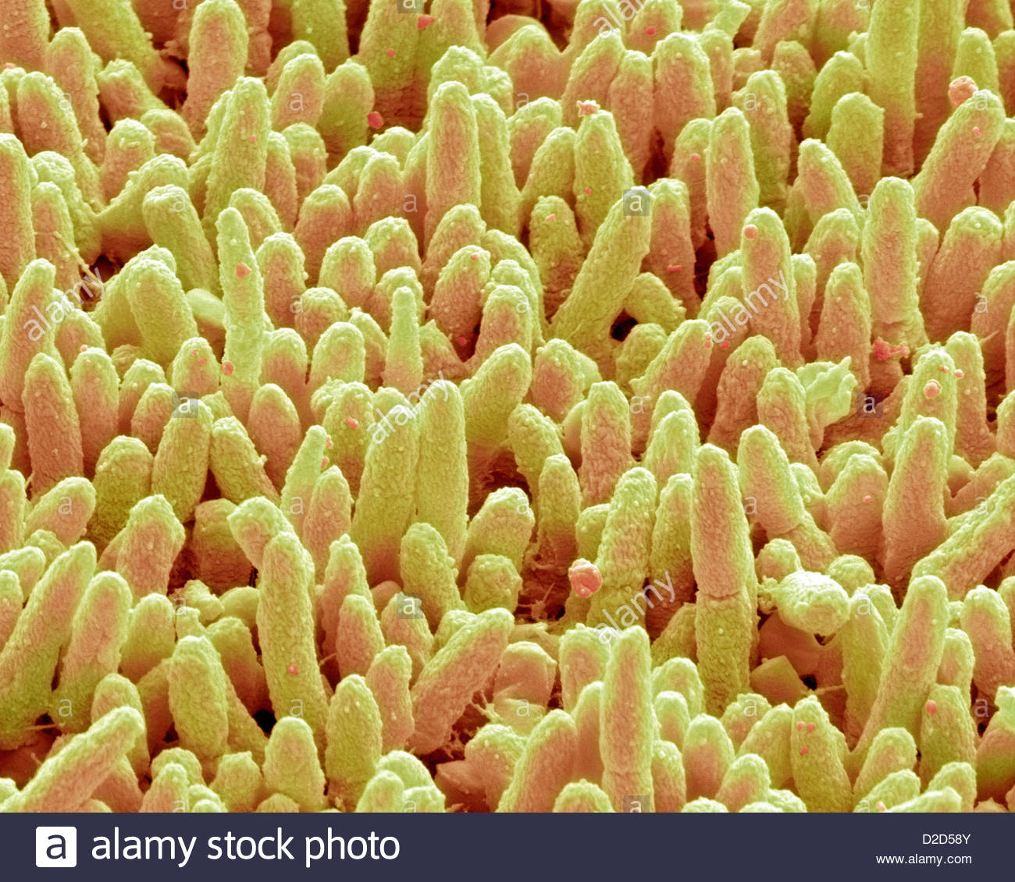
SERIOUSLY, WHO ARE THEY???

Slide 15
THE BAD GUYS!!!
The mouth contains a wide variety of oral bacteria, but only a few specific species of bacteria are believed to cause dental caries: Streptococcus mutans and Lactobacillus species among them.

Slide 16
Gum disease – what is it?
Gingivitis means inflammation of the gums, or gingiva. It commonly occurs because a film of plaque, or bacteria, accumulates on the teeth.
Signs of gingivitis include red and puffy gums that bleed easily when the person brushes their teeth.
In mild cases of gingivitis, patients may not even know they have it, because symptoms are mild.

Slide 17
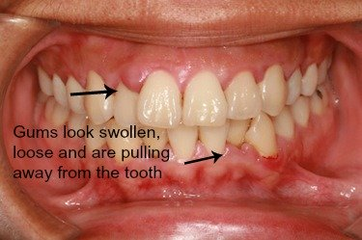
Gingivitis

Slide 18
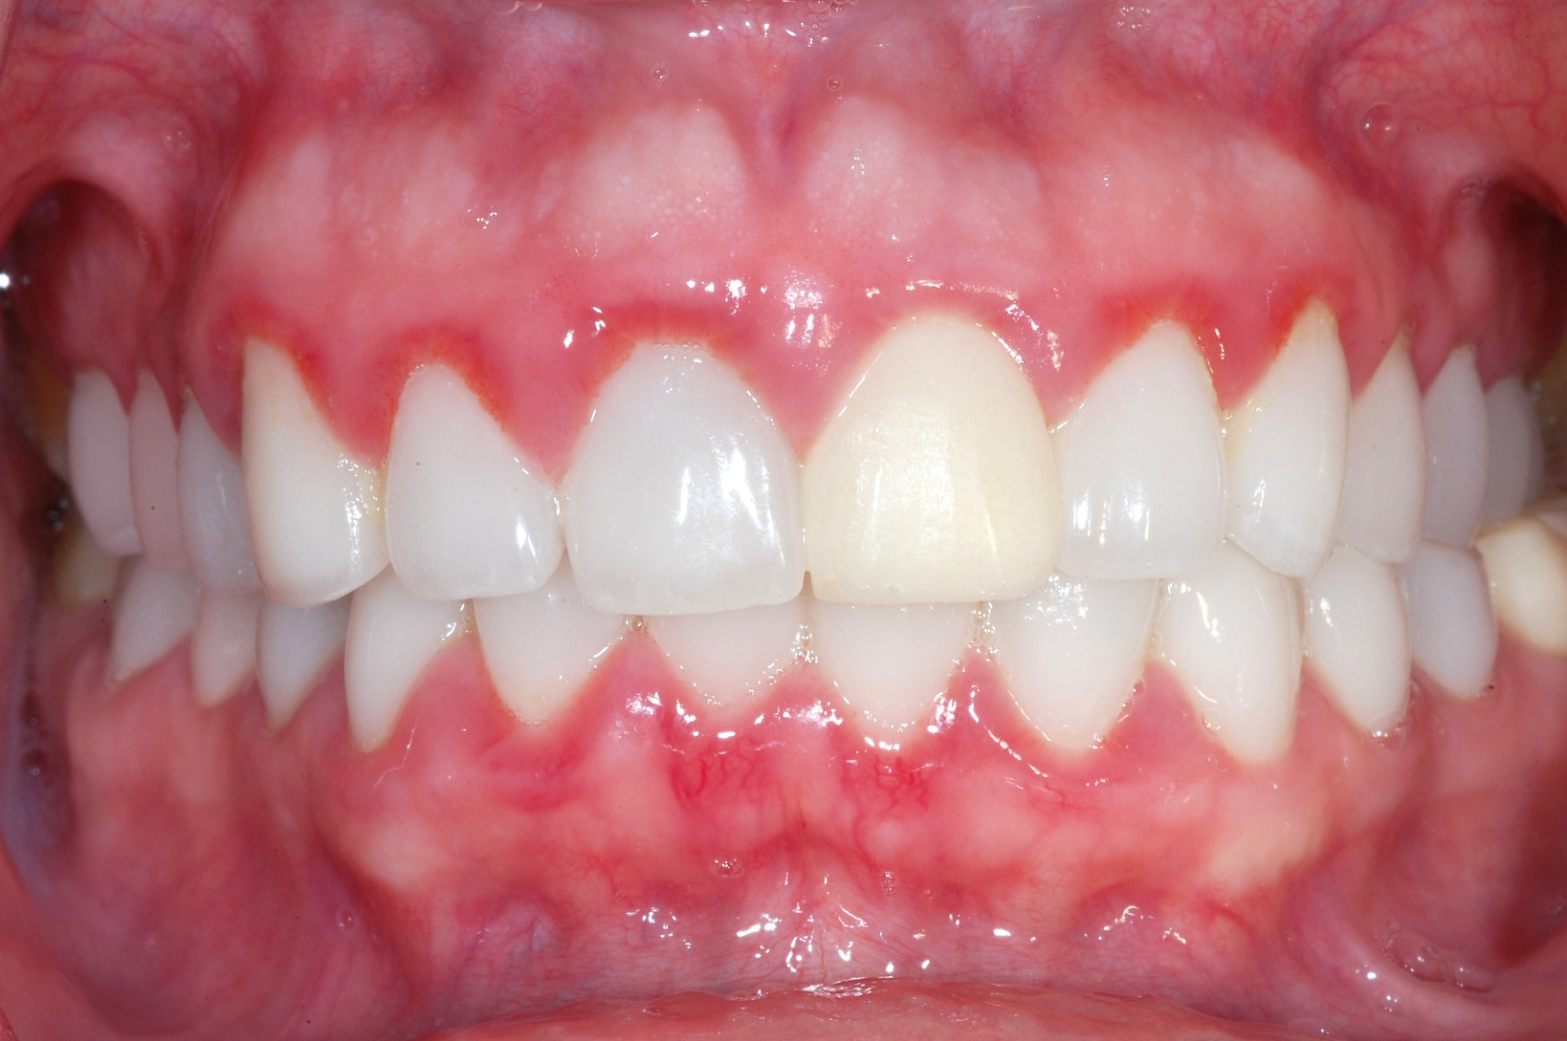
Gingivitis

Slide 19
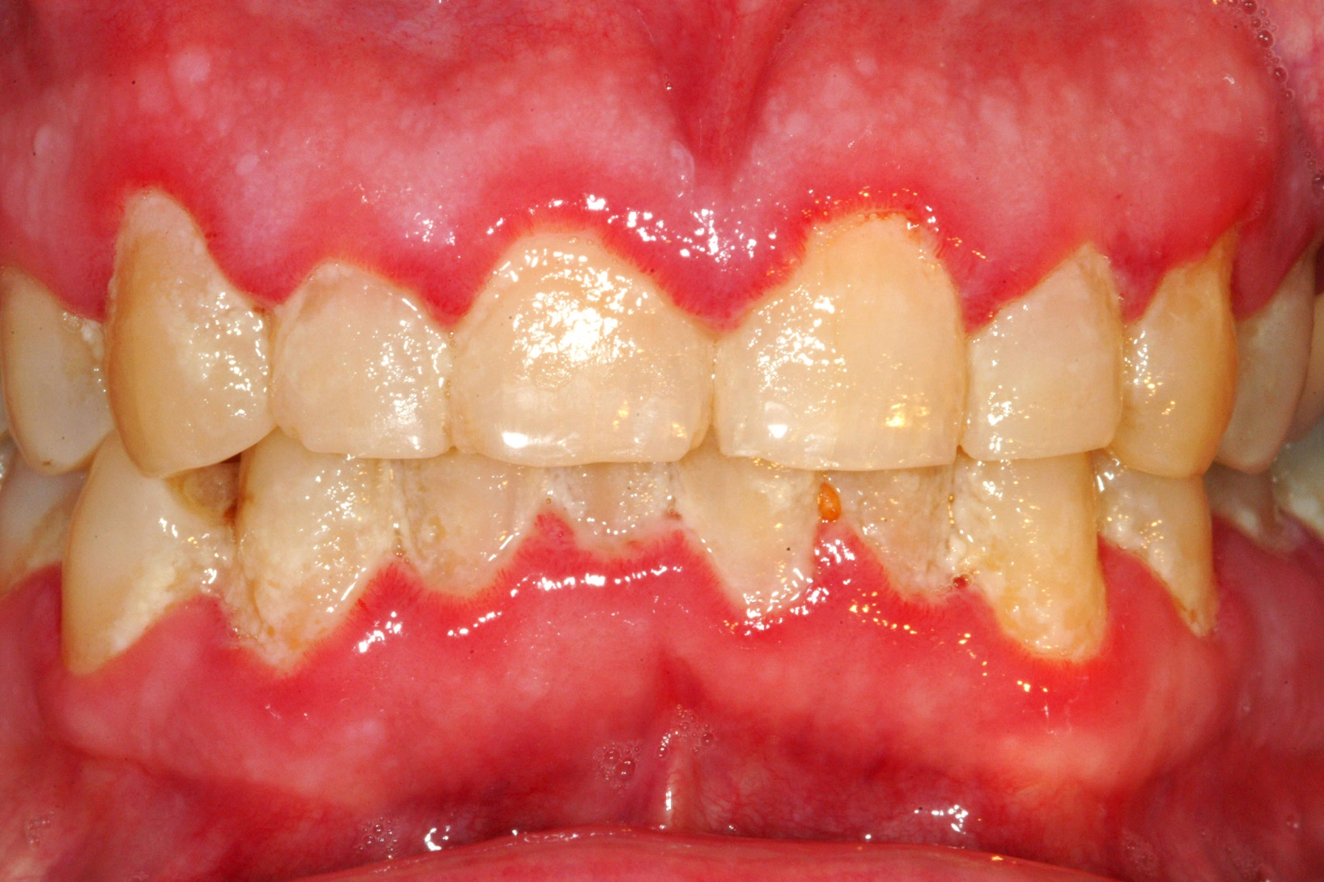
Gingivitis

Slide 20
Gingivitis is a non-destructive type of periodontal disease, but untreated gingivitis can progress to periodontitis. This is more serious and can eventually lead to loss of teeth.

Slide 21
What is periodontitis?
Periodontitis, or gum disease, is a common infection that damages the soft tissue and bone supporting the tooth. Without treatment, the alveolar bone around the teeth is slowly and progressively lost.
The name "periodontitis" means "means inflammation around the tooth.

Slide 22
What causes periodontitis?
Microorganisms, such as bacteria, stick to the surface of the tooth and in the pockets surrounding the tooth, and they multiply. As the immune system reacts and toxins are released, inflammation occurs.
Bacterial plaque, a sticky, colorless membrane that develops over the surface of teeth, is the most common cause of periodontal disease. If plaque it not removed, it can harden to form tartar, or calculus.

Slide 23
Hey, remember me???

Slide 24
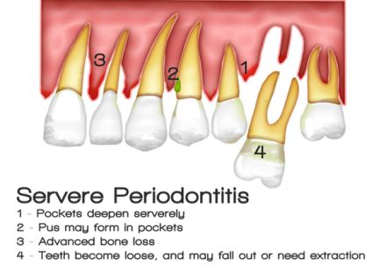
What does this mean?

Slide 25
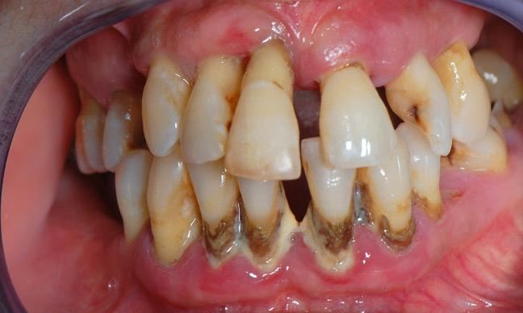
Severe Periodontitis

Slide 26
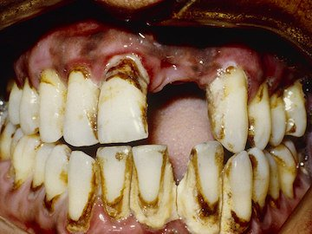
Severe Periodontitis

Slide 27
Oral Cancer
Cancer is defined as the uncontrollable growth of cells that invade and cause damage to surrounding tissue. Oral cancer appears as a growth or sore in the mouth that does not go away. Oral cancer, which includes cancers of the lips, tongue, cheeks, floor of the mouth, hard and soft palate, sinuses, and pharynx (throat), can be life threatening if not diagnosed and treated early.

Slide 28
Symptoms of Oral Cancer
Swellings/thickenings, lumps or bumps, rough spots/crusts/or eroded areas on the lips, gums, or other areas inside the mouth
The development of velvety white, red, or speckled (white and red) patches in the mouth
Unexplained bleeding in the mouth
Persistent sores on the face, neck, or mouth that bleed easily and do not heal within 2 weeks

Slide 29
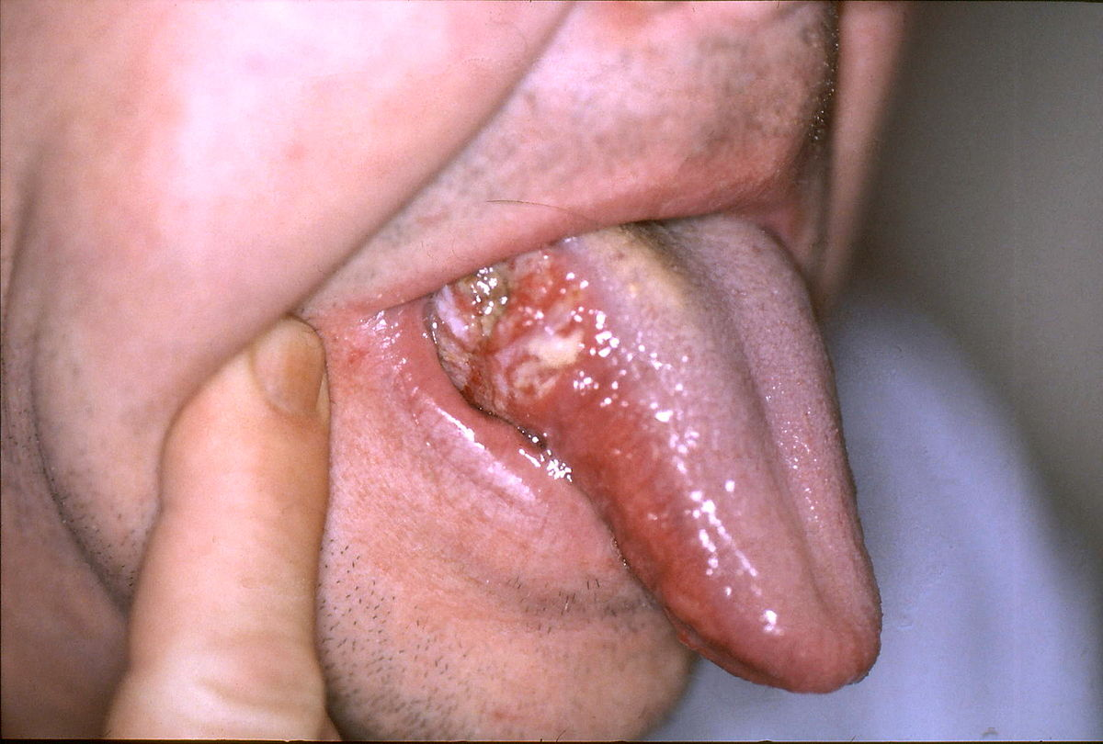
Oral Cancer on Tongue

Slide 30
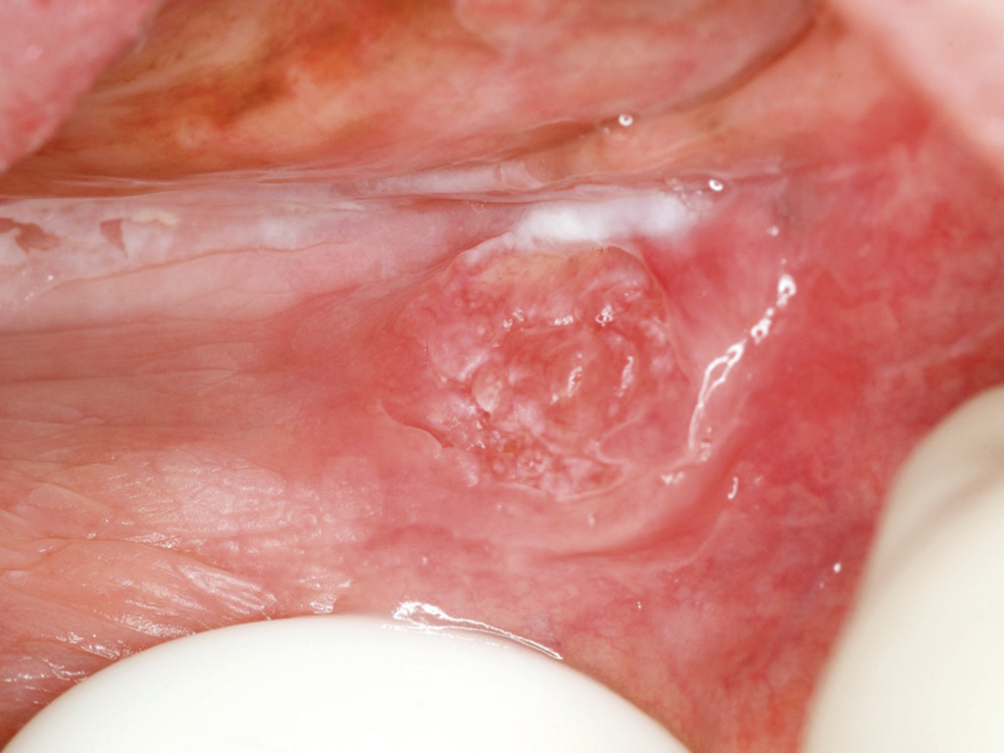
Oral Cancer on Cheek

Slide 31


Biggest Risk Factors
Chronic Alcohol Use
Cigarette Smoking

Slide 32
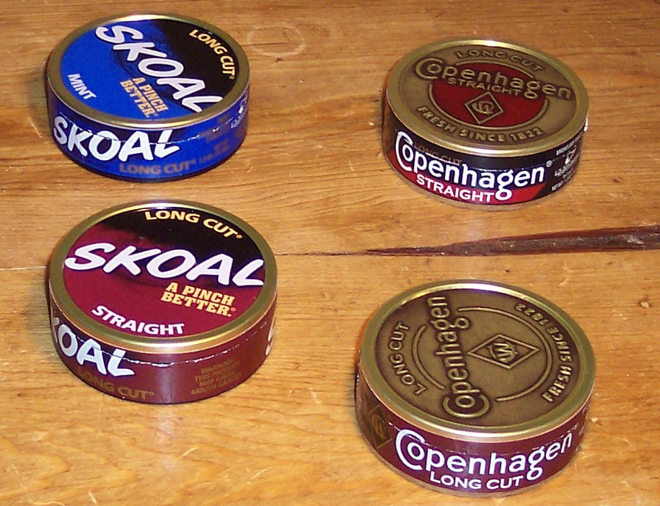

Other risk factors
Chewing tobacco
Certain Viruses

Slide 33


SMOKING, ALCOHOL, AND CHEWING TOBACCO: IS IT WORTH IT?

Slide 34

So, you’ve seen and heard all the scary stuff….
What can we do to prevent it?
How do we obtain and maintain good oral health?

Slide 35
Believe it or not, the simple, everyday choices you make can have a huge impact.
DIET, DIET, DIET!!!
Choose whole foods high in fiber and low in sugar.
Hint: Look for foods with fewer than 5 ingredients on label.

Slide 36


Slide 37
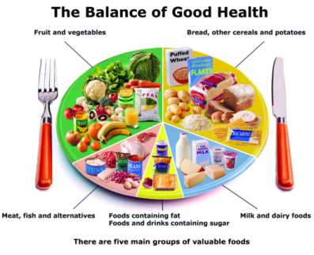

Slide 38

No matter what you eat, if it stays on your teeth too long, it will cause problems.
GOOD ORAL HYGIENE IS CRITICAL!!!

Slide 39
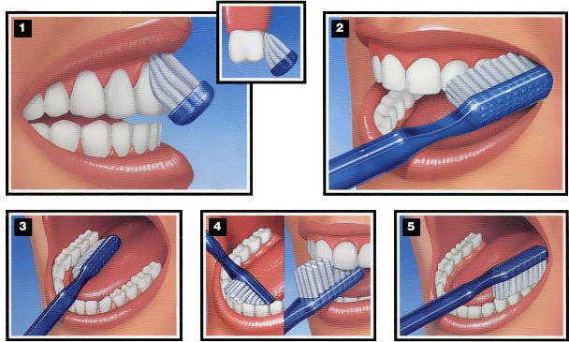
Good Oral Care: How do I brush my teeth?
Use a soft-bristled toothbrush.
Choose a tooth paste with FLUORIDE in it.
Place a pea sized amount of toothpaste on the brush.
Keep the toothbrush half on the gums and half on teeth (yes, you have to brush your gums!!!)
Spend a solid 2 minutes brushing all the surfaces of your teeth (a timer helps!!!)
Spit out the toothpaste – you don’t have to rinse. Let it stay on your teeth for extra protection!

Slide 40
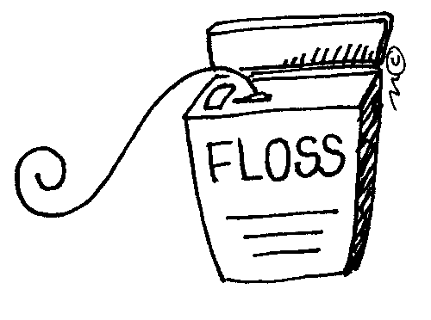
Don’t forget about me!!!
A toothbrush is great, but won’t reach all the little nooks and crannies in between your teeth, the scary stuff you can’t see!!!
You need to floss to scrape that stuff away!
Once a day is OK – before you go to bed.

Slide 41

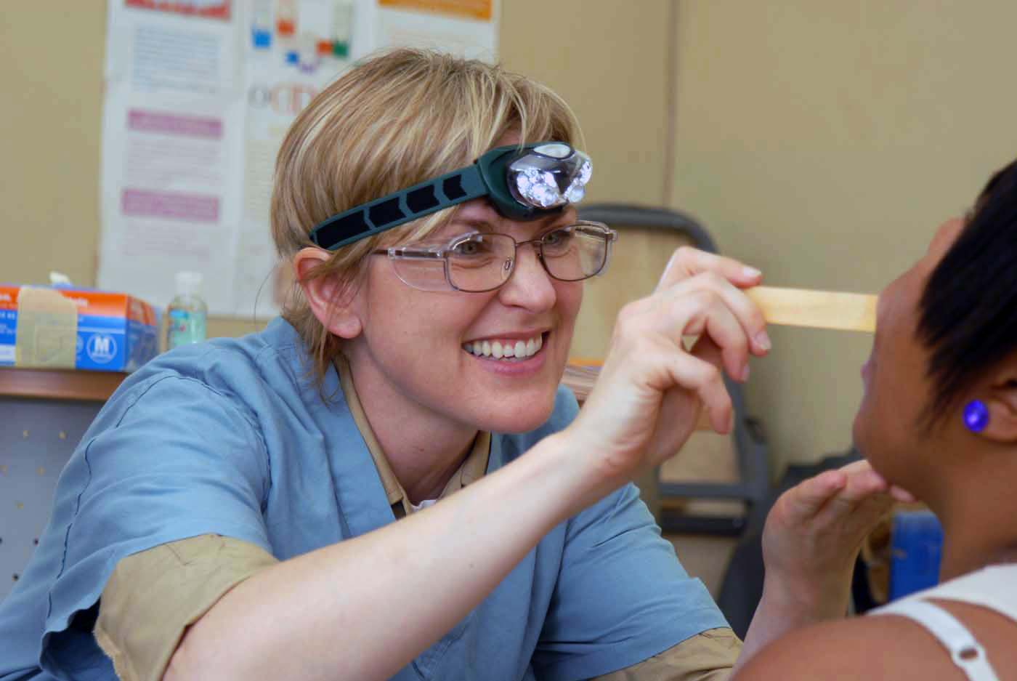
Regular dental checkups, x-rays, and cleanings help maintain your teeth and make sure problems are caught early before they get really bad.

Slide 42
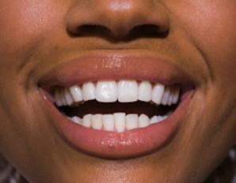
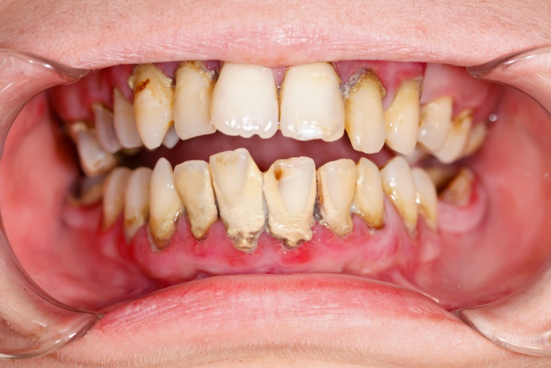
So, what do you want other people to see when they see you smile?
Nice healthy, clean teeth!
Or, whatever this is….

Slide 43

Stay Healthy!!!

