Slide 1
Brush-a-mania
2027

Slide 2
Why do we brush?
To keep them clean from food and plaque - what’s plaque?
What happens if we don’t brush?
Notes:
Starting with a simple question - why do we brush? Well mainly to… What is plaque? Plaque forms when germs and food mix. Plaque sticks to your teeth especially near the gums and between teeth. If we do not brush we might end up with a cavity.

Slide 3
What are cavities?
A cavity is a small hole in your tooth.
It starts small but it gets bigger as time goes on.
How do we know if we have a cavity?
Notes:
How do we know? Sometimes we can see it, sometimes we can feel it - when we are eating or drinking - but cavities do not always hurt!

Slide 4



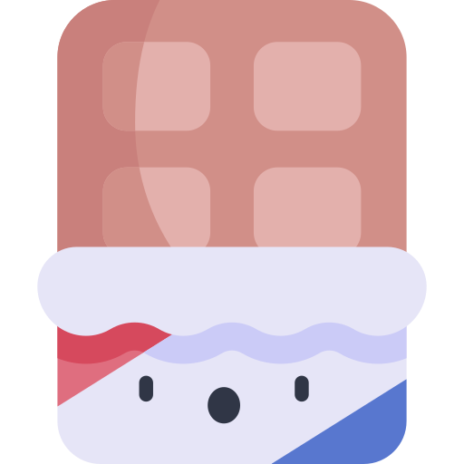
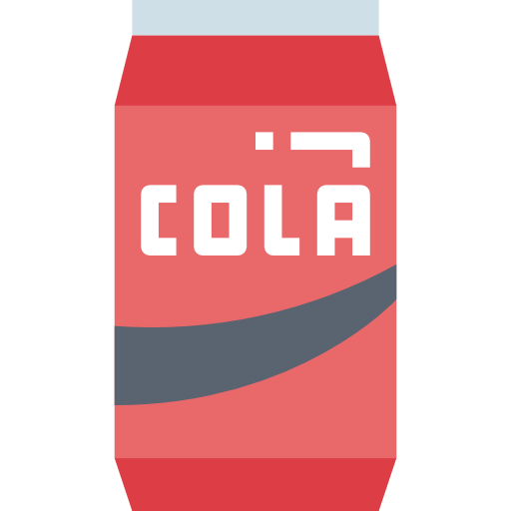
What causes cavities?
Sugary foods
Acidic food and drink
FREQUENCY
Forgetting to brush and floss
Notes:
(give examples) These things all have different roles in causing cavities. another important note is frequency - which means how many times you do something, is important too. If you have one sweet treat with dinner it’s mich better than having a sugary drink through the whole day, because every time you have a sip its giving the sugar bugs more sugar to eat!

Slide 5



What causes cavities?
Eating the wrong foods and not brushing for a long time
Bacteria (sugar bugs) make acid that melts the tooth
This makes a cavity
Notes:
Time is very important here - it takes a long time to make a cavity. This can be a little tricky to understand, but sugar bugs basically really love eating the sugar you leave on your teeth. These sugar bugs live in the plaque we talked about earlier. When they eat the sugar, they make acid which melts the tooth. Over time this makes a cavity. Acidic food and drink makes this worse because they help soften the teeth.

Slide 6
How do we stop cavities?
Notes:
Does anyone know what we can do to help fight these bugs and stop cavities?

Slide 7
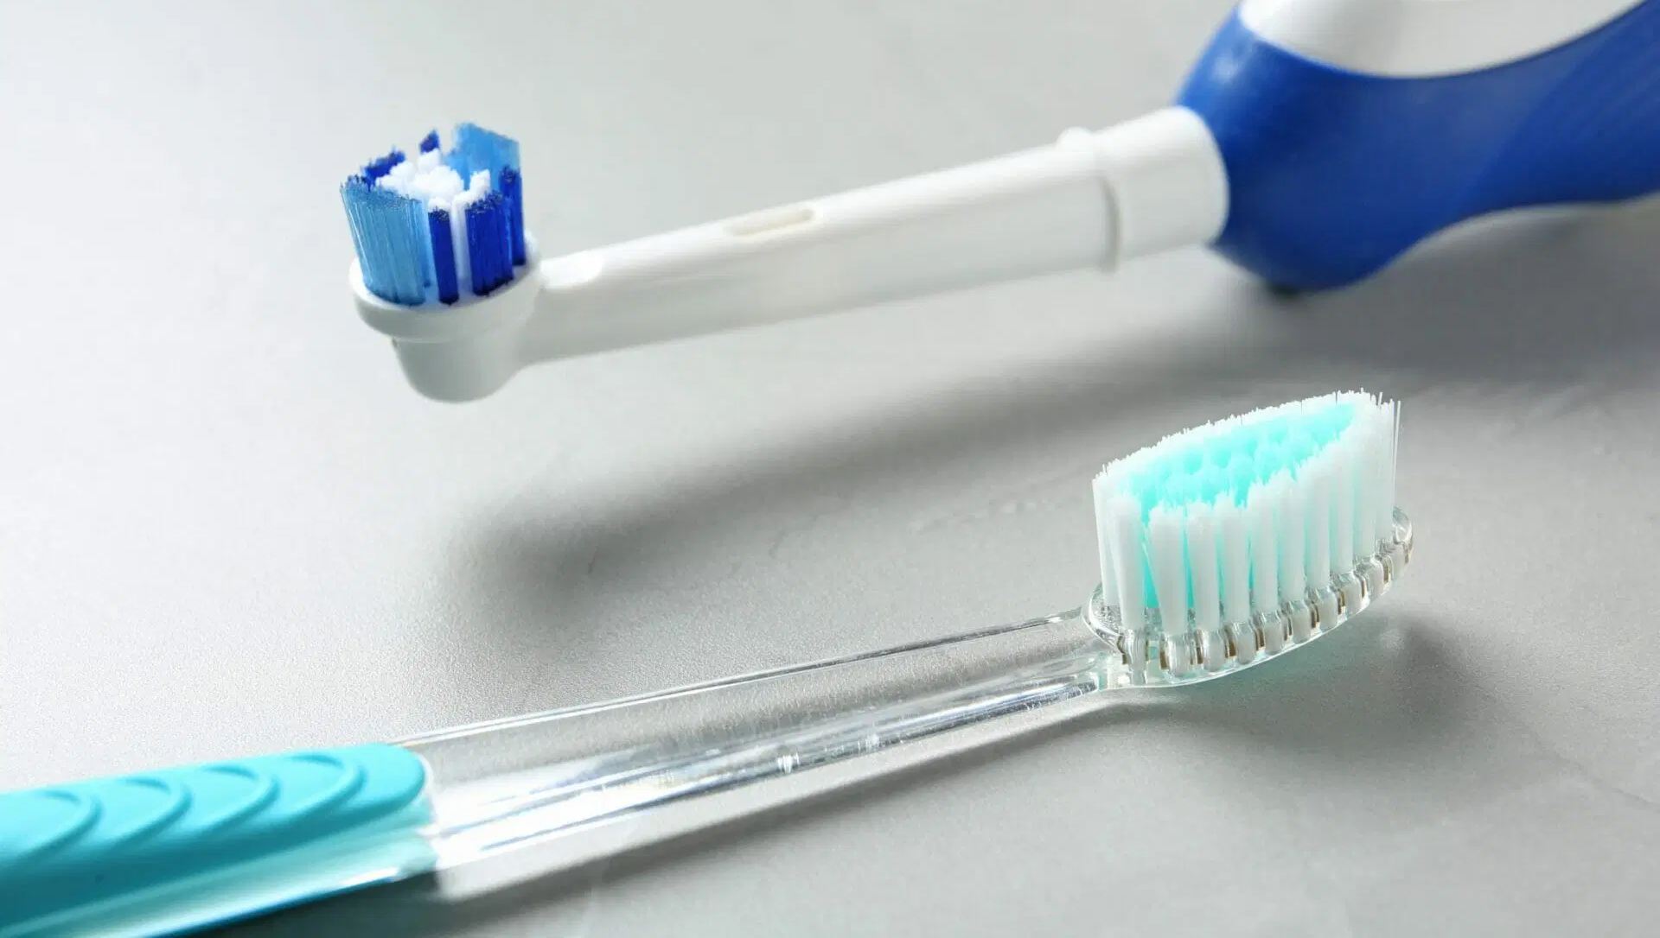
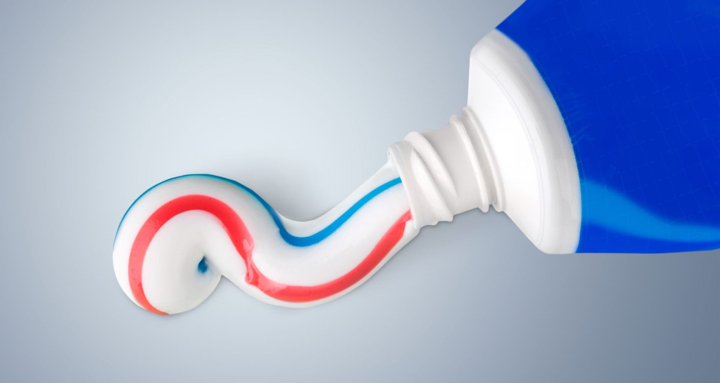
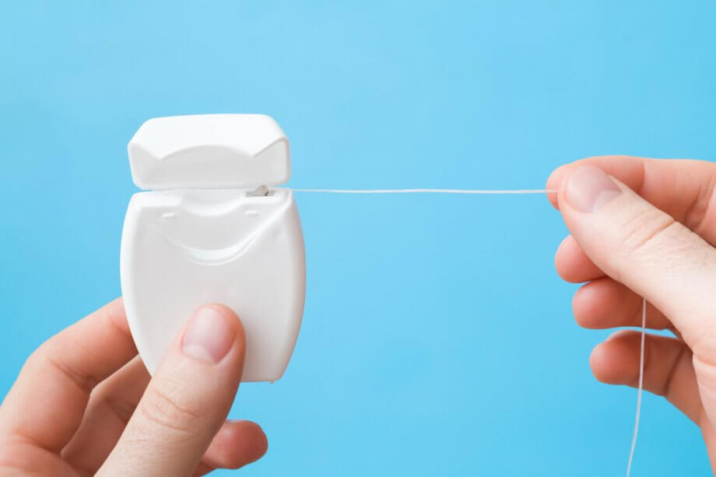
Three Tools
?
?
Notes:
Brush, toothpaste and floss

Slide 8

How many times a day?

Slide 9


How many times a day?
Notes:
Morning and night! It is important that we brush before bed, and make sure we don’t have any late night snacks after we brush!

Slide 10
How long?
Notes:
2 mins! You guys are doing amazing !

Slide 11
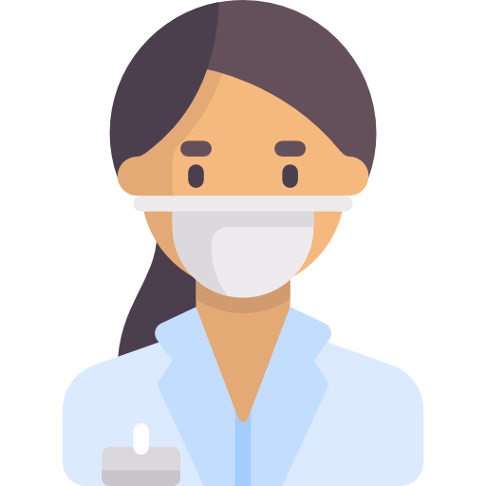
Who fixes a cavity?
Notes:
Sometimes even if we do our best, we still get a cavity. I have had cavities too! Its okay! But does anyone know who helps us when we have a cavity? A dentist! Like me! Has anyone been to the dentist before? Everyone should go to the dentist at least once a year so that we can take a look and make sure everything is healthy! We like to take a look inside the mouth and maybe even take some special pictures of your teeth called x-rays. If the dentist finds a cavity its okay, we know how to fix you right up. Let’s learn about how the dentist does that!

Slide 12

How?
Tooth is put to sleep
We clean the tooth and fill it
The tooth is healthy again
Notes:
First we give the tooth sleepy juice so it goes to sleep, and doesn’t feel anything - it goes NUMB. Then we clean the tooth with our special tools, and we use some special soap just like washing your hair - we shampoo and condition the tooth, and fill it back up with something like clay so its healthy again!

Slide 13
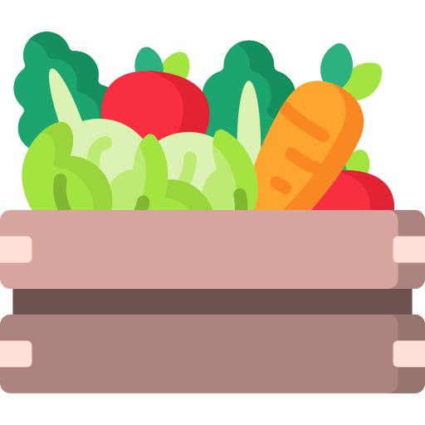
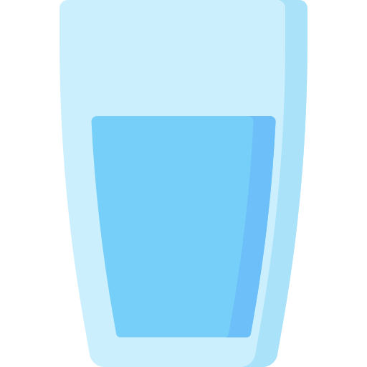
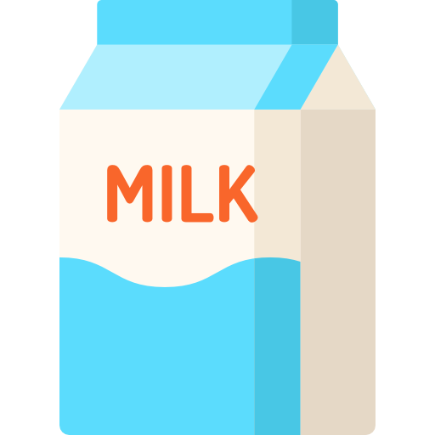


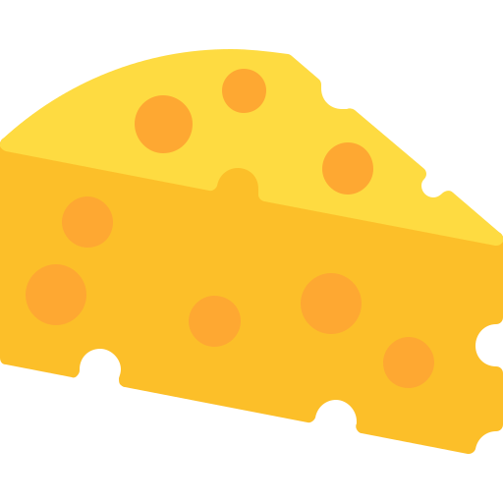

What are some healthy snacks?
Vegetables
Fruits in moderation
Dairy
Water instead of juice
Notes:
Instead of sugary foods, there are some healthy snacks we can have instead! Can anyone name some healthy snacks that are good for teeth - like we pictured here? Most important thing is? WATER! Water is super good for our teeth. We should drink water or milk, not juice or fizzy drinks with our meals! Sometimes is ok
:)

Slide 14
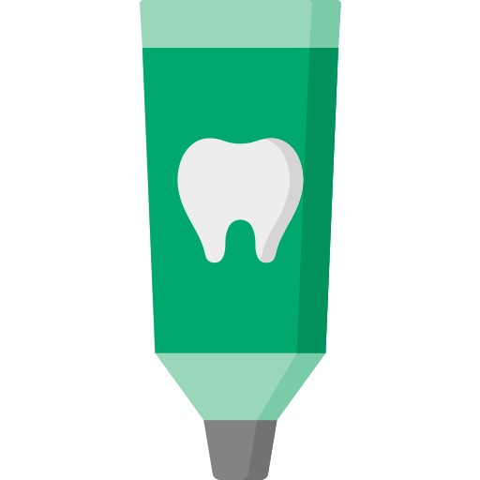
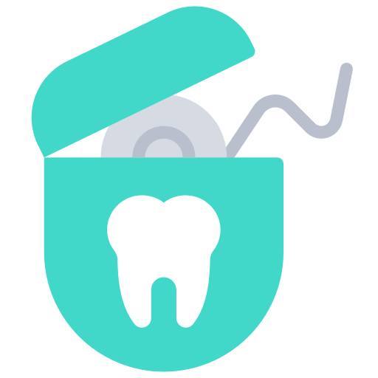

Let’s keep our teeth healthy!
2. See the dentist every year
Brushing and flossing regularly
3. Make tooth friendly choices
with our food and drink
Notes:
To wrap everything up - Can anyone name some things we can do to keep our teeth healthy like we discussed!

Slide 15
Thank you!

Slide 16
Thanks!
Please keep this slide for attribution

Slide 17
Icon pack

Slide 18
Alternative resources
Here’s an assortment of alternative resources whose style fits that of this template:
Vectors
Flat national dentist's day illustration

