Slide 1
Brush-a-mania
2027

Slide 2
Why do we brush?

Slide 3
Why do we brush?
Removes food and plaque - what’s plaque?
Prevents cavities and gum disease
Keeps your mouth fresh and healthy
Helps your overall health
Notes:
Starting with a simple question - why do we brush? Well mainly to… What is plaque? Plaque forms when germs and food mix. Plaque sticks to your teeth especially near the gums and between teeth. If we do not brush we might end up with a cavity. Helps with our health - did you know bacteria in your mouth are linked to other conditions around your body? Your heart health and tummy health are connected to the mouth!

Slide 4
What are cavities?

Slide 5
What are cavities?
A cavity is a small hole in your tooth
They start small but get bigger the longer you leave them
How do I know if I have a cavity? Cavities do not always hurt!
Notes:
How do we know? Sometimes we can see it, sometimes we can feel it - when we are eating or drinking - but cavities do not always hurt!

Slide 6


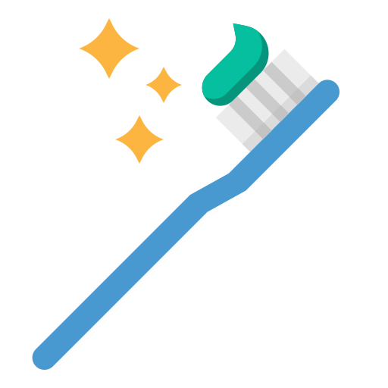

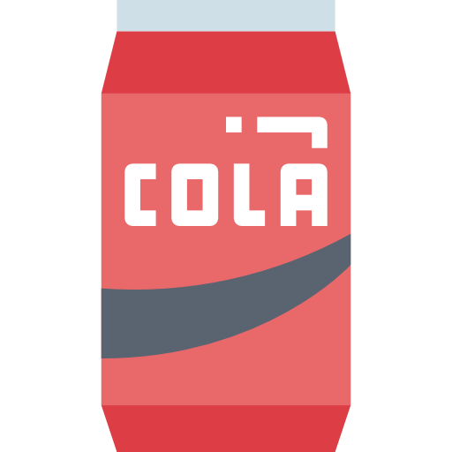
What causes cavities?
Sugary food and drinks
Acidic food and drinks
Forgetting to brush and floss
Not brushing leads to the formation of plaque on the teeth.
Notes:
(give examples) These things all have different roles in causing cavities. Another important note is frequency - which means how many times you do something, is important too. If you have one sweet treat with dinner, it’s much better than having a sugary drink through the whole day, because every time you have a sip its giving the sugar bugs more sugar to eat!

Slide 7



What causes cavities?
Bacteria (sugar bugs) that live in the plaque love eating the sugar left on your teeth!
These sugar bugs make acid when they eat the sugar
This makes the tooth soft and leads to a cavity
Notes:
Time is very important here - it takes a long time to make a cavity. This can be a little tricky to understand, but sugar bugs basically really love eating the sugar you leave on your teeth. These sugar bugs live in the plaque we talked about earlier. When they eat the sugar, they make acid which melts the tooth. Over time this makes a cavity. Acidic food and drink makes this worse because they help soften the teeth.

Slide 8
How do we stop cavities?
Toothbrush
Toothpaste
Floss

Slide 9
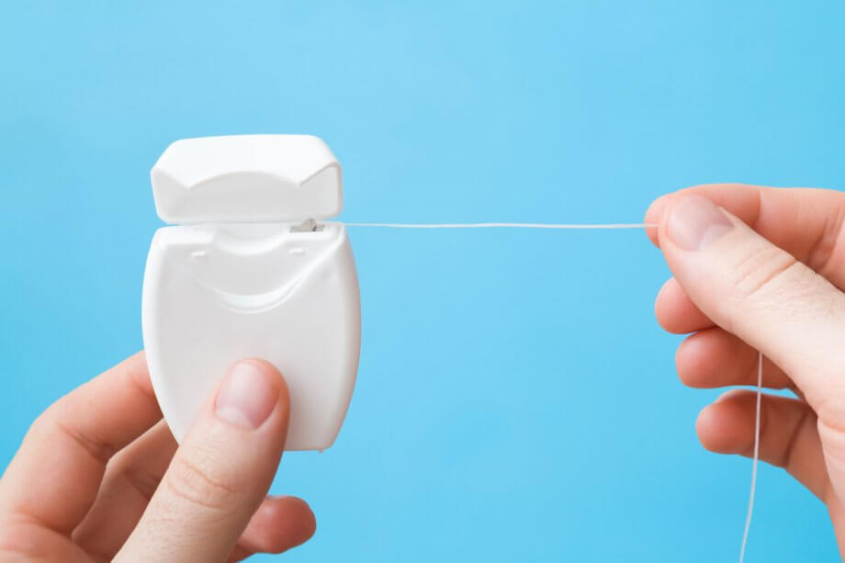
Why do we need to floss?
?
Your toothbrush can’t reach everywhere!
Floss helps remove the plaque and food stuck between your teeth

Slide 10

How many times a day?

Slide 11


How many times a day?
Notes:
Morning and night! It is important that we brush before bed, and make sure we don’t have any late night snacks after we brush!

Slide 12
How long?

Slide 13
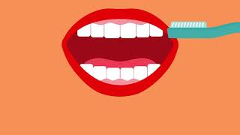
How do we brush?

Slide 14
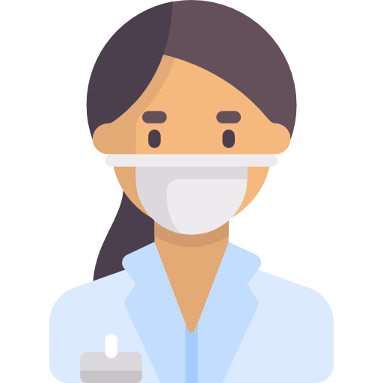
Who fixes a cavity?
A dentist fixes cavities
It’s important to see your dentist regularly to make sure you don’t have any cavities!
What might a dentist do at your check ups?
Notes:
Sometimes even if we do our best, we still get a cavity. I have had cavities too! Its okay! But does anyone know who helps us when we have a cavity? A dentist! Like me! Has anyone been to the dentist before? Everyone should go to the dentist at least once a year so that we can take a look and make sure everything is healthy! We like to take a look inside the mouth and maybe even take some special pictures of your teeth called x-rays. If the dentist finds a cavity its okay, we know how to fix you right up. Let’s learn about how the dentist does that!

Slide 15

How?!
The tooth is put to sleep -
It is now numb!
We clean the tooth with our special tools and fill it.
The tooth is healthy again.
Notes:
First we give the tooth sleepy juice so it goes to sleep, and doesn’t feel anything - it goes NUMB. Then we clean the tooth with our special tools, and we use some special soap just like washing your hair - we shampoo and condition the tooth, and fill it back up with something like clay so its healthy again!

Slide 16
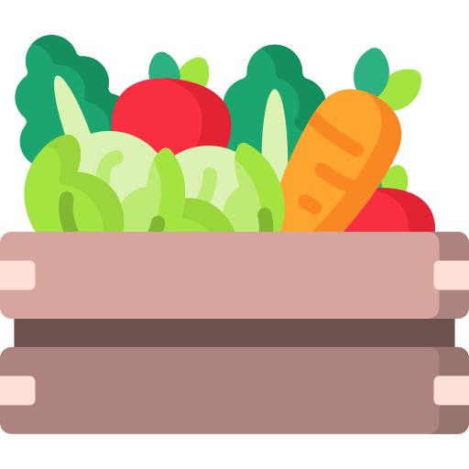
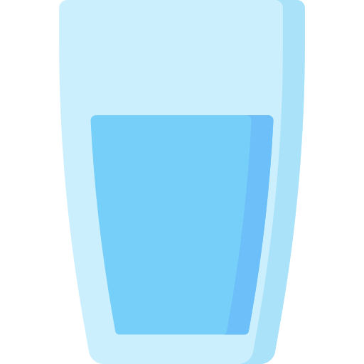
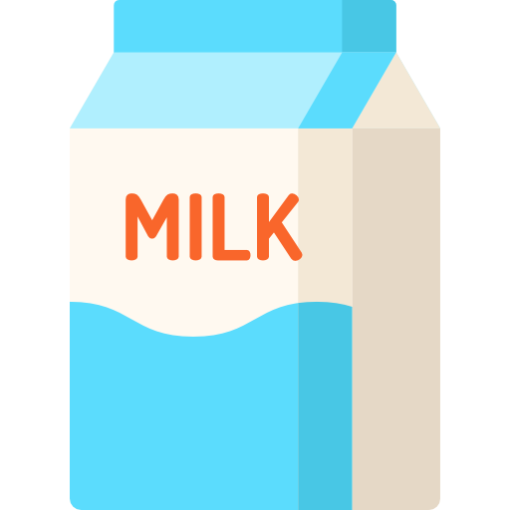


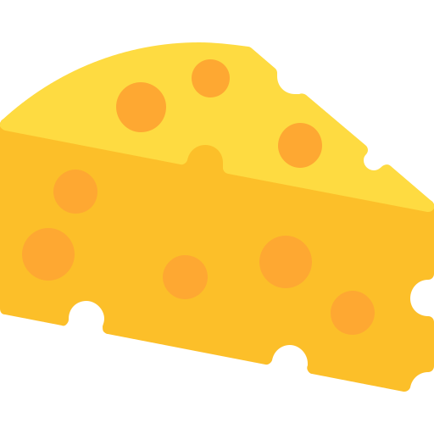

What are some healthy snacks?
Vegetables
Fruits in moderation
Dairy
Water instead of juice
Notes:
Instead of sugary foods, there are some healthy snacks we can have instead! Can anyone name some healthy snacks that are good for teeth - like we pictured here? Most important thing is? WATER! Water is super good for our teeth. We should drink water or milk, not juice or fizzy drinks with our meals! Sometimes is ok :)

Slide 17
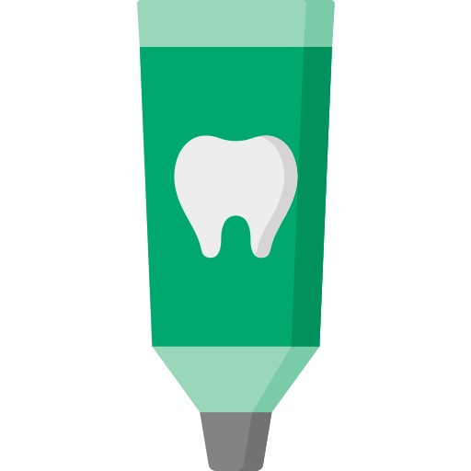
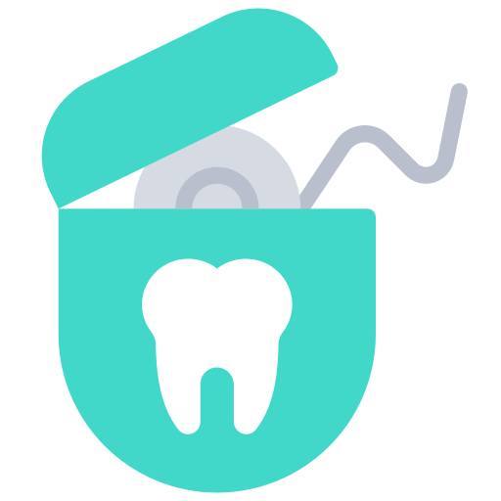
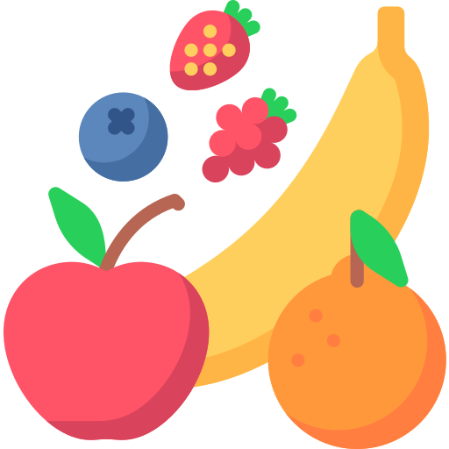
Let’s keep our teeth healthy!
2. See your dentist every year
Brushing and flossing regularly
3. Make tooth friendly choices
with your food and drink
Notes:
To wrap everything up - Can anyone name some things we can do to keep our teeth healthy like we discussed! Should we … exercise our teeth? Nooo. Should we … take them on a walk! Nooooo…. Should we … brush and floss? Yessssss. Go to the dentist once a year to get them checked? Yessss. Should we eat tooth healthy snacks? Yess Should we avoid sugar foods? Yes!

Slide 18
Thank you!
Notes:
It has been so much fun to chat with you guys. Did everyone get a sticker? I will go around and give one to everyone! Lets also make sure you get your goody bags. Does anyone have any questions at all? Thank you guys so much for being such good listeners and giving me such good answers! I hope you guys learned a little! Don’t forget to brush!

Slide 19
Thanks!
Please keep this slide for attribution

Slide 20
Icon pack

Slide 21
Alternative resources
Here’s an assortment of alternative resources whose style fits that of this template:
Vectors
Flat national dentist's day illustration

