Slide 1
Brush-a-mania
2027

Slide 2
Why do we brush?

Slide 3
Why do we brush?
Removes food and plaque
Prevents cavities and gum disease
Keeps your mouth fresh and healthy
Helps your overall health
Notes:
Starting with a simple question - why do we brush? Well mainly to… What is plaque? Plaque forms when germs and food mix. Plaque sticks to your teeth especially near the gums and between teeth. If we do not brush we might end up with a cavity. Helps with our health - did you know bacteria in your mouth are linked to other conditions around your body? Your heart health and tummy health are connected to the mouth - DIABETES AND CARDIOVASCULAR DISEASE

Slide 4
What are cavities?

Slide 5
What are cavities?
A cavity is a small hole in your tooth
They start small but get bigger the longer you leave them
How do I know if I have a cavity? Cavities do not always hurt!
Notes:
How do we know? Sometimes we can see it, sometimes we can feel it - when we are eating or drinking - but cavities do not always hurt!

Slide 6



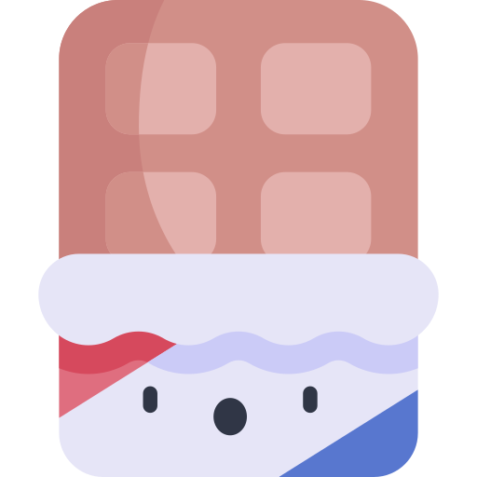
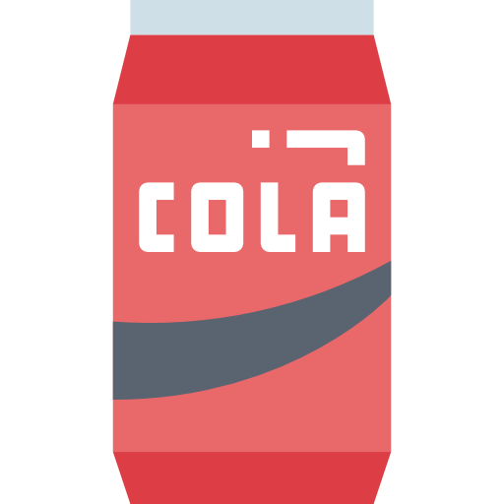
What causes cavities?
Sugary food and drinks
Acidic food and drinks
Forgetting to brush and floss
Not brushing leads to the formation of plaque on the teeth.
Notes:
(give examples) These things all have different roles in causing cavities. Another important note is frequency - which means how many times you do something, is important too. If you have one sweet treat with dinner, it’s much better than having a sugary drink through the whole day, because every time you have a sip its giving the sugar bugs more sugar to eat!

Slide 7



What causes cavities?
Bacteria (sugar bugs) that live in the plaque love eating the sugar left on your teeth!
These sugar bugs make acid when they eat the sugar
This makes the tooth soft and leads to a cavity
Notes:
Time is very important here - it takes a long time to make a cavity. This can be a little tricky to understand, but sugar bugs basically really love eating the sugar you leave on your teeth. These sugar bugs live in the plaque we talked about earlier. When they eat the sugar, they make acid which melts the tooth. Over time this makes a cavity. Acidic food and drink makes this worse because they help soften the teeth.

Slide 8
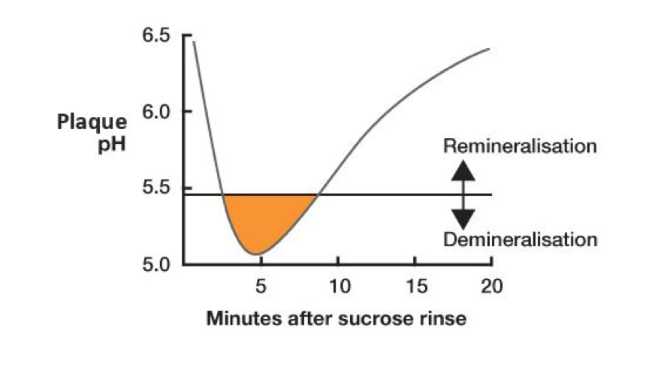
What causes cavities?
Notes:
Right after you eat sugary foods or drinks, the bacteria in your mouth turn the sugar into acid.
This makes the pH drop quickly (meaning your mouth gets more acidic).
If the pH goes below 5.5, your teeth start to lose minerals — this is how cavities start.
After a while, your saliva helps the pH go back up, and your teeth can start to rebuild.
The more often your mouth goes below pH 5.5, the more likely you are to get cavities.
That’s why snacking on sugar all day is worse than having it once and brushing after!

Slide 9
How do we stop cavities?
Toothbrush
Toothpaste
Floss

Slide 10
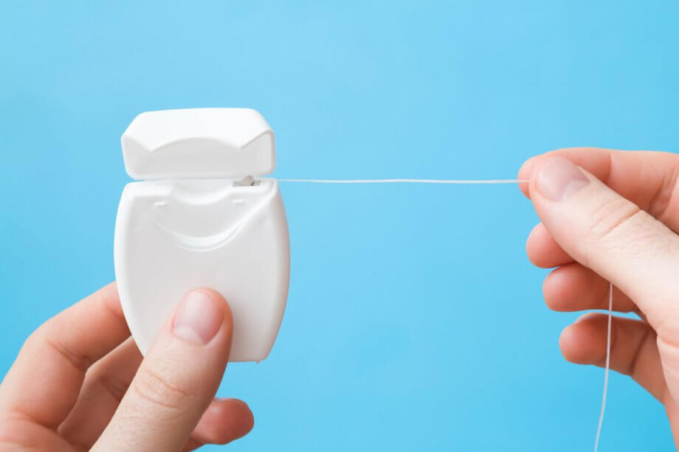
Why do we need to floss?
?
Your toothbrush can’t reach everywhere!
Floss helps remove the plaque and food stuck between your teeth.

Slide 11

How many times a day?

Slide 12


How many times a day?
Notes:
Morning and night! It is important that we brush before bed, and make sure we don’t have any late night snacks after we brush!

Slide 13
How long?
Notes:
2 mins! You guys are doing amazing !

Slide 14
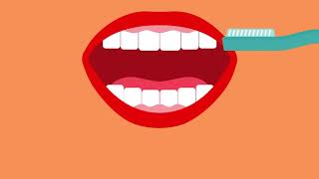
How do we brush?
Notes:
Who brushes alone? Who brushes with someone? Let's do it together! Up and down and all around! Don’t forget the back teeth! And spit out the extra toothpaste! Don’t rinse! And remember - always brush gently! We don’t want to hurt our teeth or gums!

Slide 15
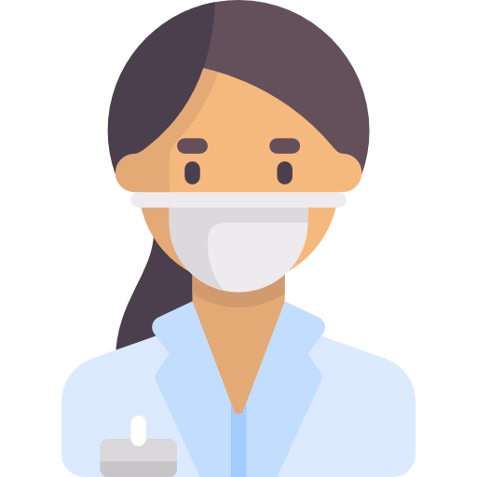
Who fixes a cavity?
A dentist fixes cavities.
It’s important to see your dentist regularly to make sure you don’t have any cavities!
What might a dentist do at your check ups?
Notes:
Sometimes even if we do our best, we still get a cavity. I have had cavities too! Its okay! But does anyone know who helps us when we have a cavity? A dentist! Like me! Has anyone been to the dentist before? Everyone should go to the dentist at least once a year so that we can take a look and make sure everything is healthy! We like to take a look inside the mouth and maybe even take some special pictures of your teeth called x-rays. If the dentist finds a cavity its okay, we know how to fix you right up. Let’s learn about how the dentist does that!

Slide 16
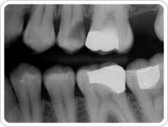
Who fixes a cavity?
Notes:
Sometimes even if we do our best, we still get a cavity. I have had cavities too! Its okay! But does anyone know who helps us when we have a cavity? A dentist! Like me! Has anyone been to the dentist before? Everyone should go to the dentist at least once a year so that we can take a look and make sure everything is healthy! We like to take a look inside the mouth and maybe even take some special pictures of your teeth called x-rays. If the dentist finds a cavity its okay, we know how to fix you right up. Let’s learn about how the dentist does that!

Slide 17

How?!
The tooth is put to sleep -
It is now numb!
We clean the tooth with our special tools and fill it.
The tooth is healthy again.
Notes:
First we give the tooth anesthetic - with a needle - so it goes to sleep, and doesn’t feel anything - it goes NUMB. After, we clean it with our drill and some specialised tools. We then condition the tooth with some soap, etc. We fill it back up with a clay like mixture that goes hard under blue light.

Slide 18
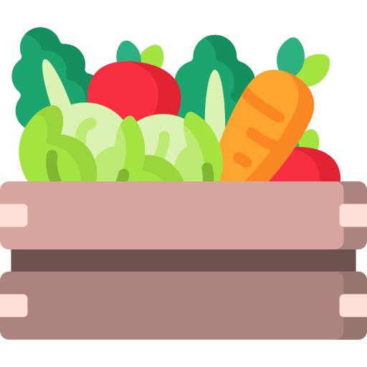
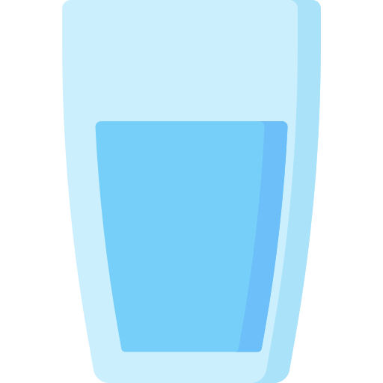
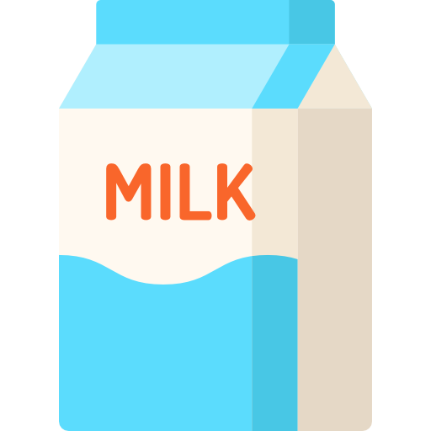


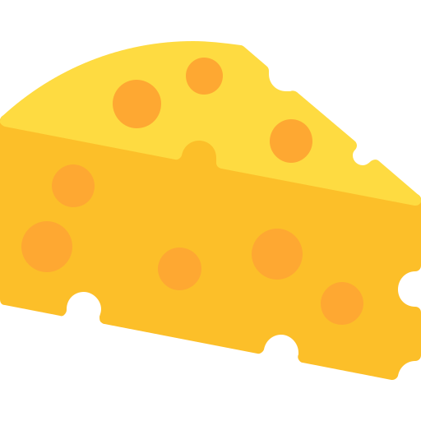

What are some healthy snacks?
Vegetables
Fruits in moderation
Dairy
Water instead of juice
Notes:
Instead of sugary foods, there are some healthy snacks we can have instead! Can anyone name some healthy snacks that are good for teeth - like we pictured here? Most important thing is? WATER! Water is super good for our teeth. We should drink water or milk, not juice or fizzy drinks with our meals! Sometimes is ok :)

Slide 19
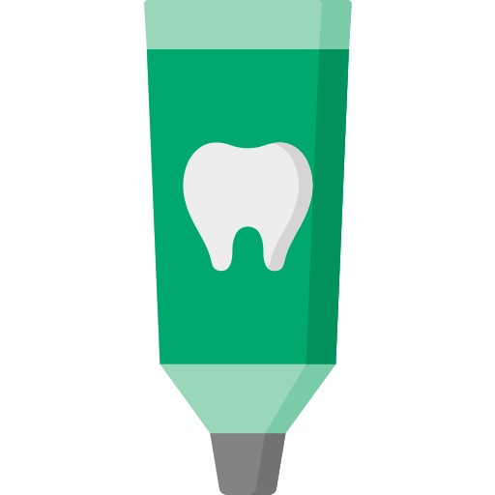
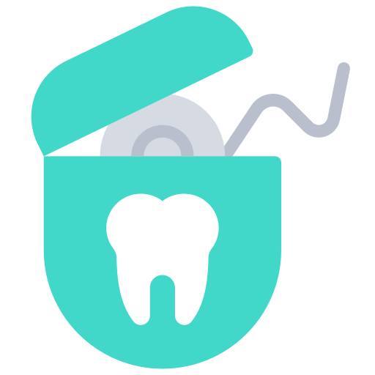

Let’s keep our teeth healthy!
2. See the dentist every year
Brushing and flossing regularly
3. Make tooth friendly choices
with your food and drink
Notes:
To wrap everything up - Can anyone name some things we can do to keep our teeth healthy like we discussed!

Slide 20
Thank you!

Slide 21
Thanks!
Please keep this slide for attribution

Slide 22
Icon pack

Slide 23
Alternative resources
Here’s an assortment of alternative resources whose style fits that of this template:
Vectors
Flat national dentist's day illustration

