Slide 1
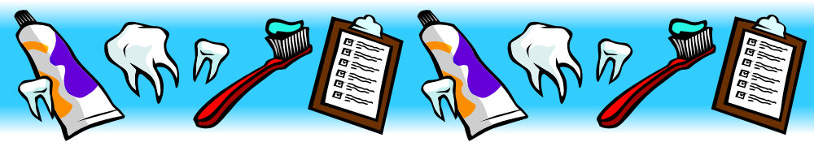
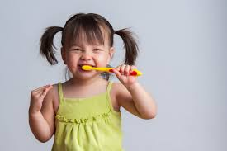

2027
BRUSH-A-MANIA
APRIL IS ORAL HEALTH MONTH

Slide 2
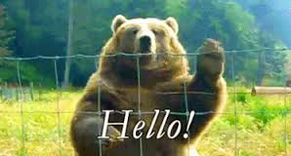

SILENCE PLEASE
Thank You

Slide 3
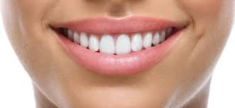
Hey everyone! I’m Dr. _________ a dentist. Every year I visit schools during Oral Health Month to talk about starting up and keeping up good habits to make sure your gums and teeth stay nice and healthy! There is more to having a healthy mouth than just brush your gums and floss your teeth.

Slide 4
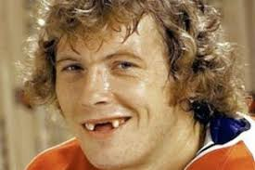
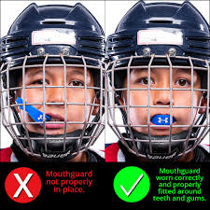
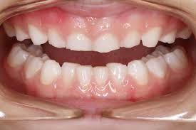
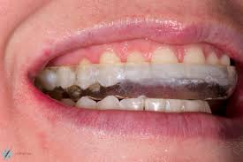
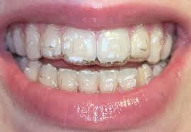
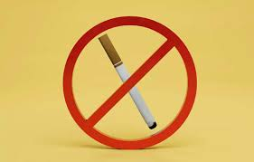
Why is it important to keep your mouth healthy?

Slide 5
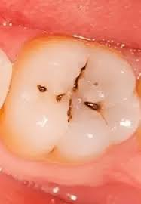
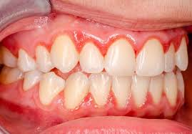
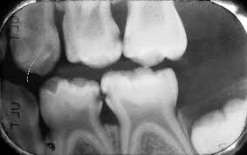
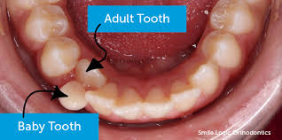
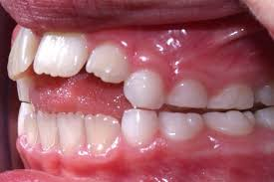
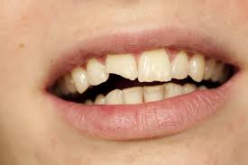
What are some signs of dental problems?

Slide 6
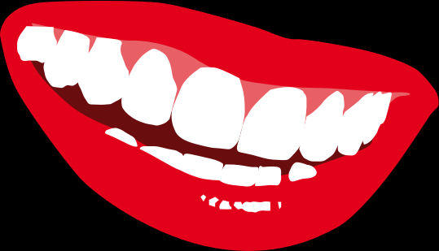
Three things you can do at home to keep your smile healthy:
1) Floss, then brush your teeth every day.
2) Eat and drink healthy things.
3) Visit your dentist at least once a year.

Slide 7
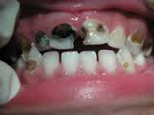
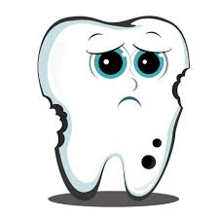
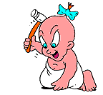
What are cavities?
&
What causes tooth DECAY?
What are cavities and what causes them?

Slide 8
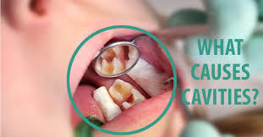
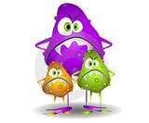

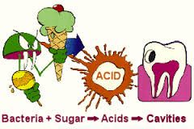
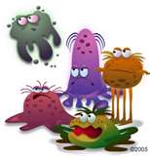

Slide 9
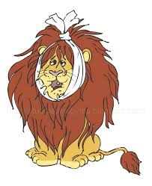

DOES ANYONE WANT A TOOTH THAT HURTS ?
NO

Slide 10
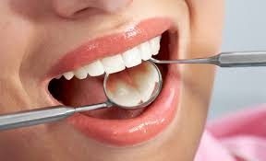
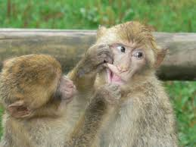
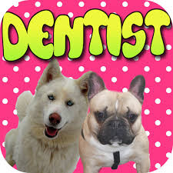
WHO FIXES A TOOTH CAVITY ?

Slide 11
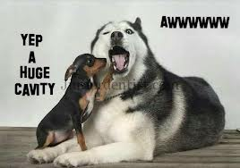
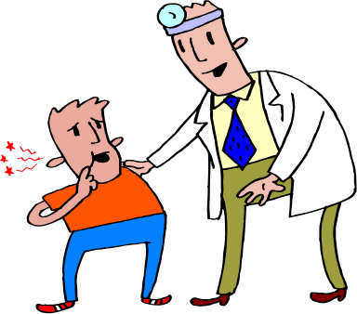
YOUR DENTIST !!

Slide 12
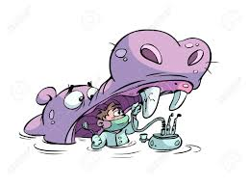
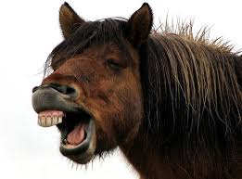
How does a Dentist fix a tooth cavity ?

Slide 13

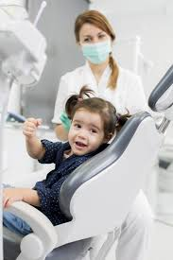
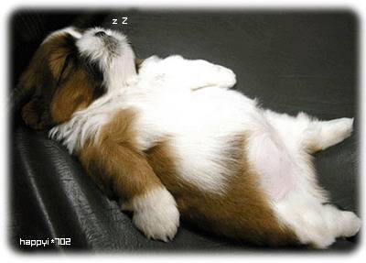
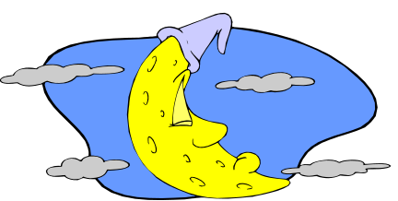
They put the tooth to sleep most of the time!
Then they fill it!

Slide 14
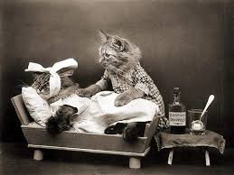
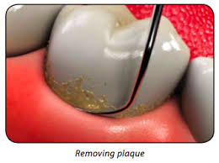
What is plaque?

Slide 15
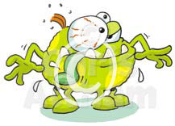
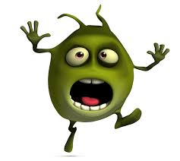
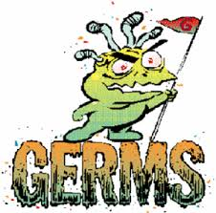
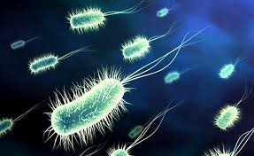
Bacteria
Bugs
Germs

Slide 16
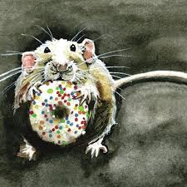
MAKE
IT
HARDER
PLAQUE N E E DS TO STAY I N
O N E S POT
FOR A LONG TIME

Slide 17
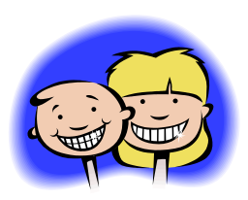
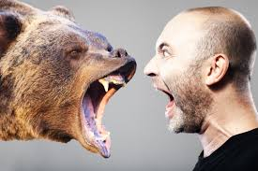
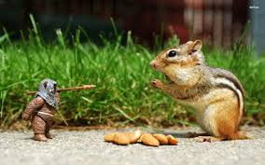
HOW DO WE ATTACK
PLAQUE?

Slide 18
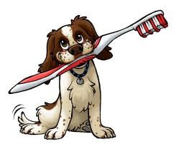
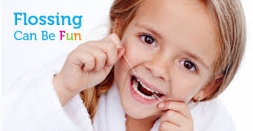
Flossing
Brushing

Slide 19
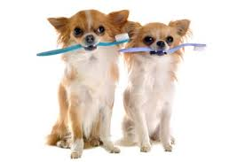
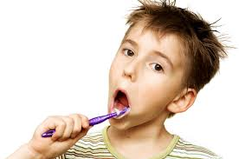
How many times a
day should
we brush?

Slide 20
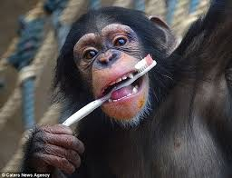

TWO
TIMES

Slide 21


WHEN DO WE BRUSH ?

Slide 22



Morning
and
Before Bedtime

Slide 23


WHAT ARE THE DIFFERENT WAYS OF BRUSHING ?

Slide 24



In Circles
Up and
Down

Slide 25


HOW LONG DO WE HAVE TO BRUSH OUR TEETH ?

Slide 26



Slide 27


A L W A Y S B R U S H
G E N T L Y

Slide 28



Do I have to brush my tongue ?

Slide 29





Slide 30



WHAT ARE HEALTHY SNACKS ?

Slide 31







Fruits
Cheese
Vegetables

Slide 32




HOW TO KEEP YOUR TEETH IN GREAT SHAPE ?

Slide 33





.
Floss everyday
Brush TWICE a day with fluoride toothpaste
Visit your dentist every 6 months

Slide 34




Eat healthy foods
Stay away from sugary treats
Wear a mouth protector while playing sports

Slide 35

If you cannot brush after snacking, be sure to drink lots of water to flush out your mouth. Should you DRINK tap or bottled water?

Slide 36

chewing xylitol gum is good! Why?

Slide 37


THANK YOU
FOR
BEING PART OF
BRUSH-A-MANIA
2027
.

Slide 38

THE END

