Slide 1
Brush-a-mania
2027

Slide 2
Why do we brush?
Notes:
Okay guys, does anyone know why we brush our teeth? CLEAN! GET BITS OF FOOD OUT! Does anyone know what might happen if we don’t brush? - CAVITY

Slide 3
What are cavities?
Notes:
A cavity is a small hole in your tooth! As we can see in the picture - does Miss tooth look happy? NOOOOOO

Slide 4





What causes cavities?
Notes:
CAN ANYONE TELL ME FROM THE PICTURES SOME THINGS THAT MIGHT CAUSE CAVITIES?! Cavities are caused by not brushing and eating sugary or acidic (sour) foods! Miss tooth is not happy!

Slide 5



What causes cavities?
Notes:
Eating these foods AND not brushing for a long time is what gives you cavities! Can everyone see the little guys bothering Miss tooth right now? These little guys are called bacteria or sugar bugs - they live in your cavities and make them bigger! You might be wondering - How do I know if I have a cavity? Sometimes it can be sore when you eat and drink or you might look in the mirror and see a hole in your tooth!

Slide 6
How do we stop cavities?
Notes:
Does anyone know what we can do to help fight these bugs and stop cavities? Lets get some guesses! Okay, let’s see.

Slide 7
Guessing game
?
?
?
You use me in your mouth, I am small and I have bristles. What am I?
I’m colorful and foamy and help clean your teeth. What am I?
I am thin and clean where the brush cannot reach. What am I?
___________
___________
___________
Notes:
We are going to do a guessing game! There's 3 things we need to help stop cavities and I need your help figuring it out - can anyone help me figure it out from these clues? I am going to read one out at a time, and then let’s all guess what it could be! 1, 2, and 3 is a little hard, I will be so impressed if anyone can guess what it is… thats okay, it was a hard one! Lets see if we got it right, what do we think?!

Slide 8
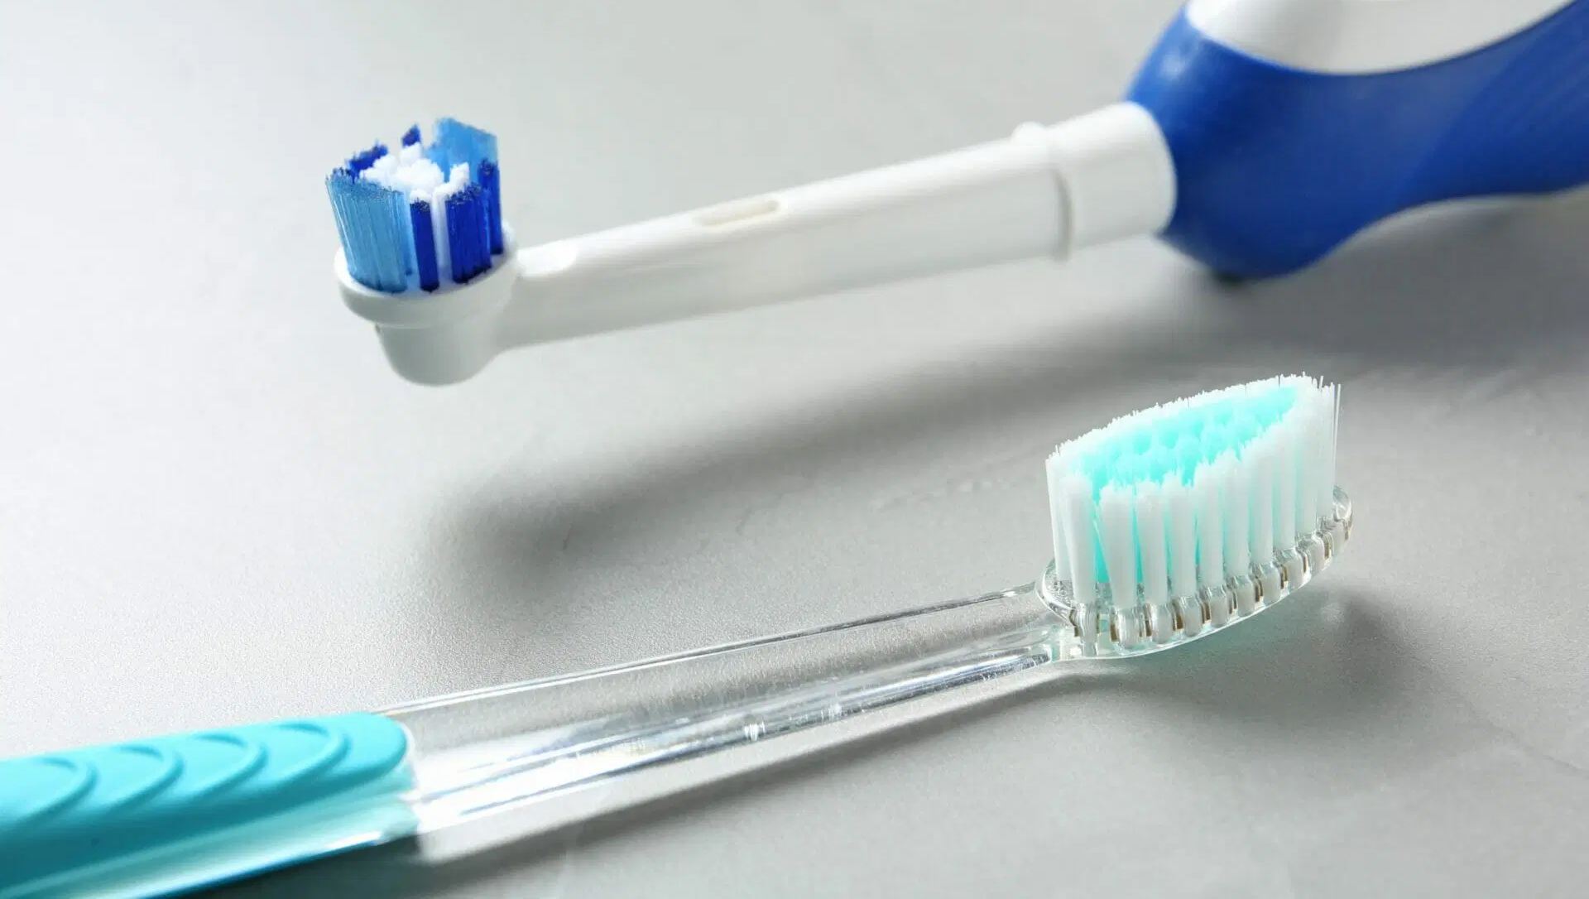
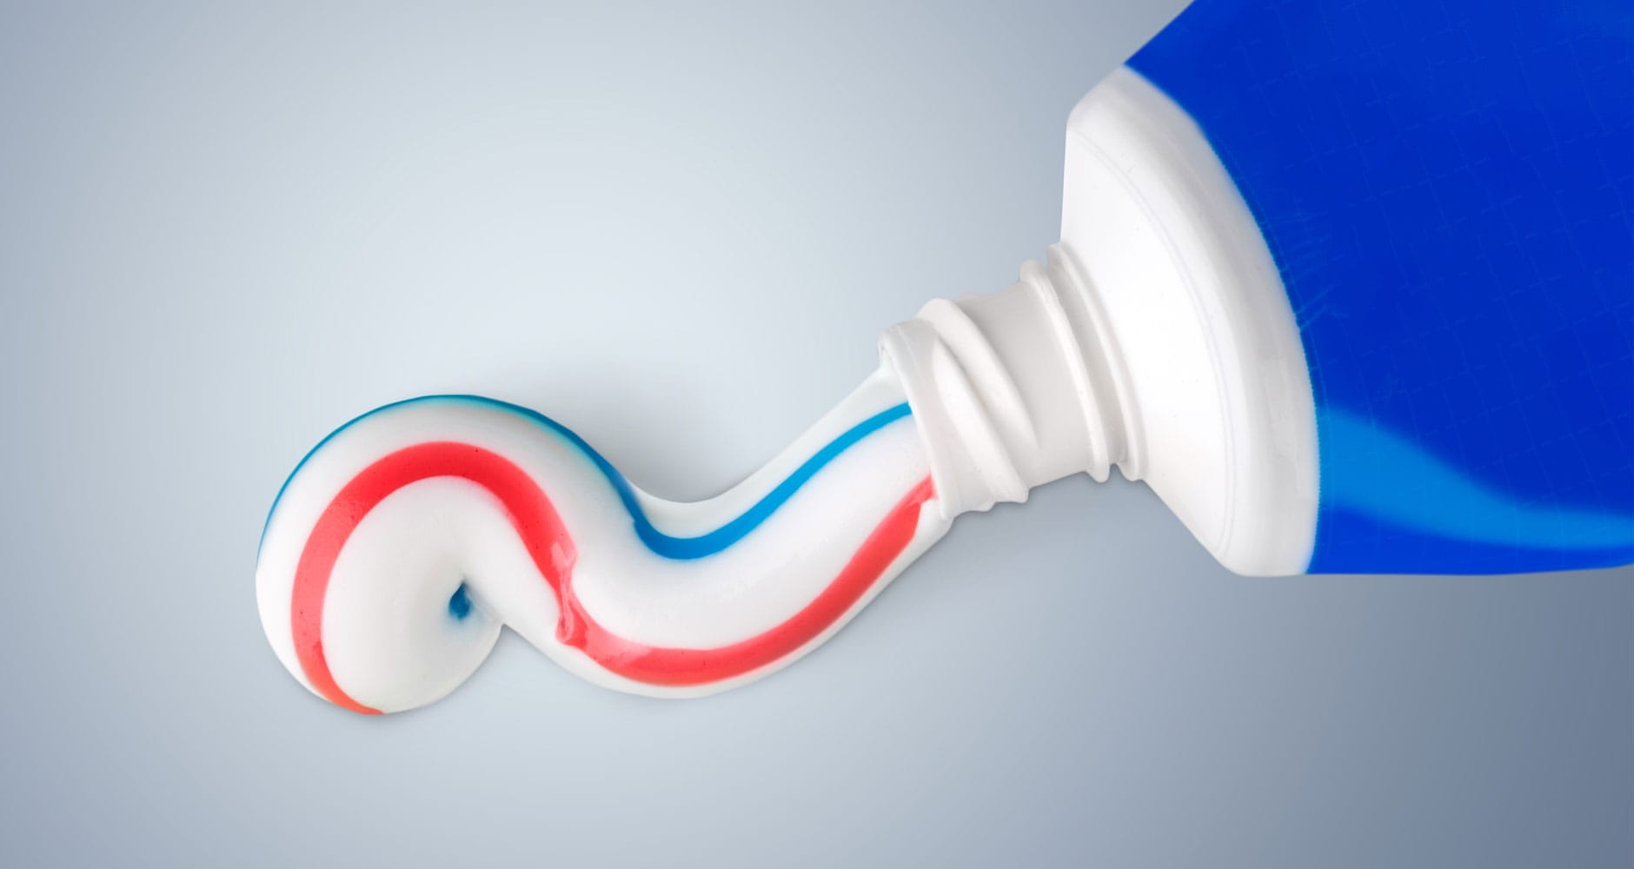
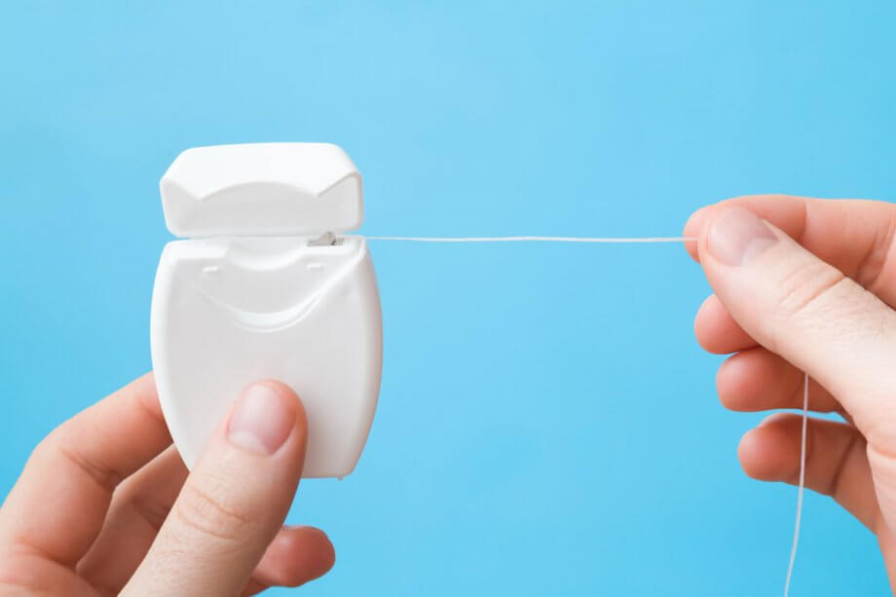
Guessing game
?
?
?
You use me in your mouth, I am small and I have bristles. What am I?
I’m colorful and foamy and help clean your teeth. What am I?
I am thin and clean where the brush cannot reach. What am I?
toothbrush!
toothpaste!
floss!

Slide 9
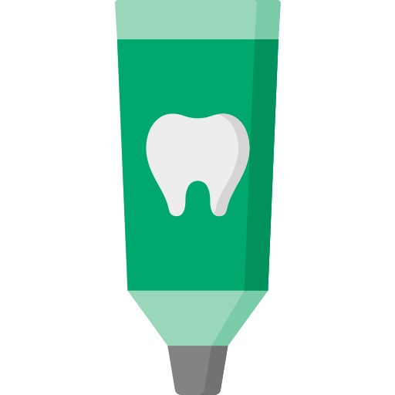


How do we stop cavities?
Notes:
These are the things we can use to help fight cavities and bugs!

Slide 10
How many times a day?

Slide 11


How many times a day?
Notes:
Morning and night! It is important that we brush before bed, and make sure we don’t have any late night snacks after we brush!

Slide 12
How long?
Notes:
2 mins! You guys are doing amazing !

Slide 13
How do we brush?

Slide 14
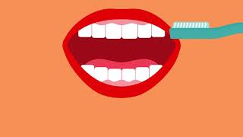
How do we brush?

Slide 15

Who fixes a cavity?
Notes:
Sometimes even if we do our best, we still get a cavity. I have had cavities too! Its okay! But does anyone know who helps us when we have a cavity? A dentist! Like me! Has anyone been to the dentist before? Everyone should go to the dentist at least once a year so that we can take a look and make sure everything is healthy! If the dentist finds a cavity its okay, we know how to fix you right up? Let’s learn about how the dentist does that!

Slide 16

How?!
Notes:
First we give the tooth sleepy juice so it goes to sleep and doesn’t feel anything - it goes NUMB. Then we clean the tooth with our special tools, just like washing your hair - we shampoo and condition the tooth and fill it back up so its healthy again!

Slide 17


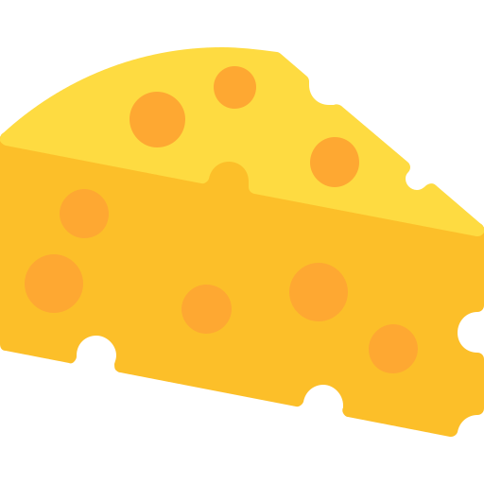




What are some healthy snacks?
Notes:
Instead of sugary foods, there are some healthy snacks we can have instead! Can anyone name some healthy snacks that are good for teeth - like we pictured here? Most important thing is? WATER! Water is super good for our teeth. We should drink water or milk, not juice or fizzy drinks with our meals! Sometimes is ok :)

Slide 18

Let’s keep our teeth healthy!
Notes:
To wrap everything up - Can anyone name some things we can do to keep our teeth healthy like we discussed! Should we … exercise our teeth? Nooo. Should we … take them on a walk! Nooooo…. Should we … brush and floss? Yessssss. Go to the dentist once a year to get them checked? Yessss. Should we eat tooth healthy snacks? Yessss. Should we avoid sugar foods? Yes!

Slide 19
Thank you!
Notes:
It has been so much fun to chat with you guys. Did everyone get a sticker? I will go around and give one to everyone! Lets also make sure you get your goody bags. Does anyone have any questions at all? Thank you guys so much for being such good listeners and giving me such good answers! I hope you guys learned a little! Don’t forget to brush!

Slide 20
Thanks!
Please keep this slide for attribution

Slide 21
Icon pack

Slide 22
Alternative resources
Here’s an assortment of alternative resources whose style fits that of this template:
Vectors
Flat national dentist's day illustration

