Slide 1
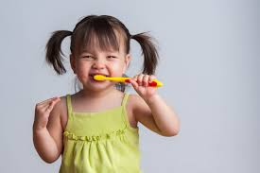

2024
BRUSH-A-MANIA
APRIL IS ORAL HEALTH MONTH

Slide 2
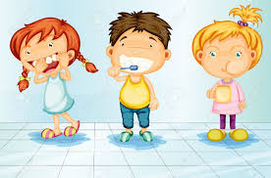
Welcome to
Brush-a-mania
2024

Slide 3
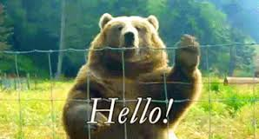

SILENCE PLEASE
Thank You

Slide 4
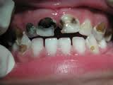
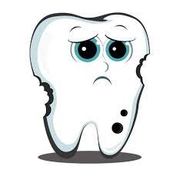
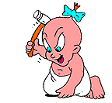
What are cavities?
&
What causes tooth DECAY?
What are cavities and what causes them?

Slide 5
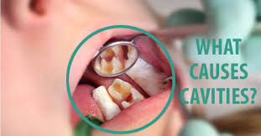
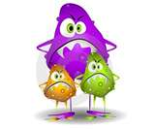

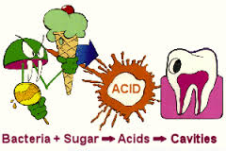
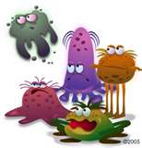

Slide 6
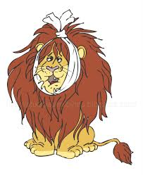

DOES ANYONE WANT A TOOTH THAT HURTS ?
NO

Slide 7
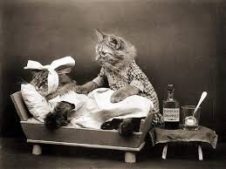
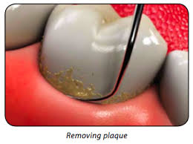
What is plaque?

Slide 8
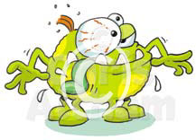
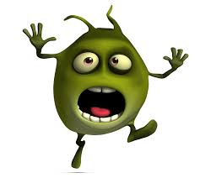
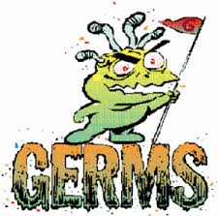
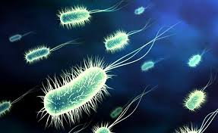
Bacteria
Bugs
Germs

Slide 9
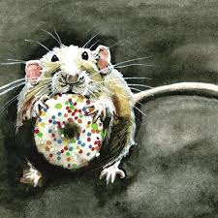
MAKE
IT
HARDER
PLAQUE N E E DS TO STAY I N
O N E S POT
FOR A LONG TIME

Slide 10
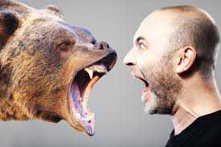
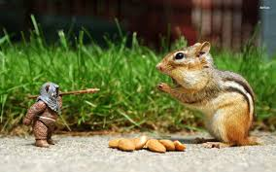
HOW DO WE ATTACK
PLAQUE?

Slide 11
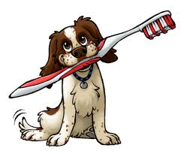
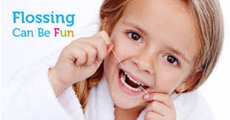
Flossing
Brushing

Slide 12
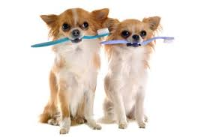
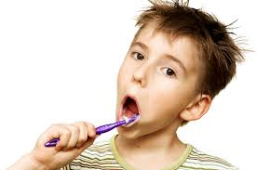
How many times a
day should
we brush?

Slide 13
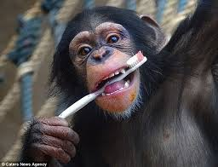

TWO
TIMES

Slide 14
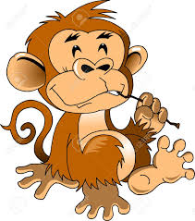
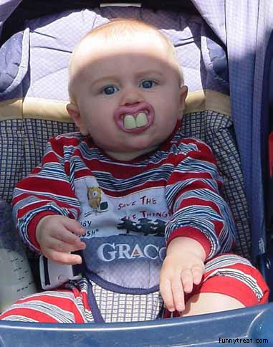
WHEN DO WE BRUSH ?

Slide 15
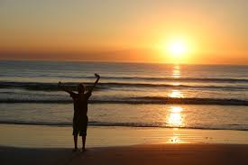
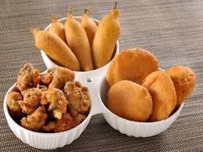
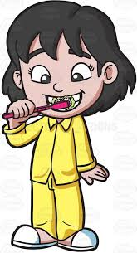
Morning
and
Before Bedtime

Slide 16
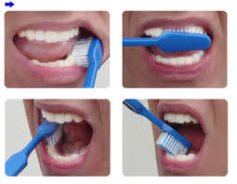
WHAT ARE THE DIFFERENT WAYS OF BRUSHING ?

Slide 17

In Circles
Up and
Down

Slide 18
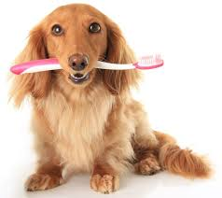
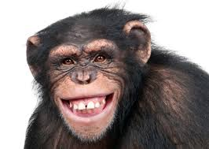
HOW LONG DO WE HAVE TO BRUSH OUR TEETH ?

Slide 19

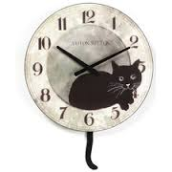

Slide 20

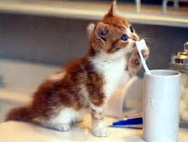
A L W A Y S B R U S H
G E N T L Y

Slide 21
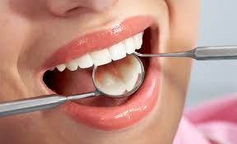
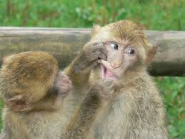
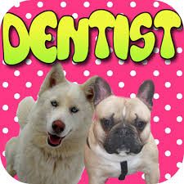
WHO FIXES A TOOTH CAVITY ?

Slide 22
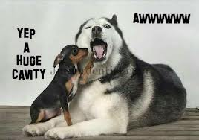
YOUR DENTIST !!

Slide 23
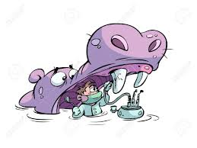
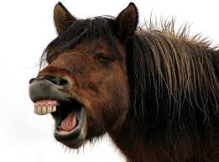
How does a Dentist fix a tooth cavity ?

Slide 24

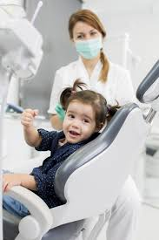

They put the tooth to sleep most of the time!
Then they fill it!

Slide 25
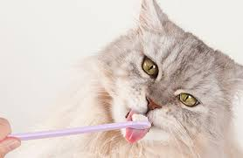

Do I have to brush my tongue ?

Slide 26
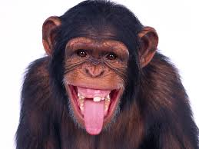

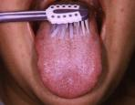


Slide 27

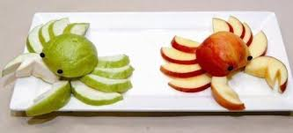
WHAT ARE HEALTHY SNACKS ?

Slide 28


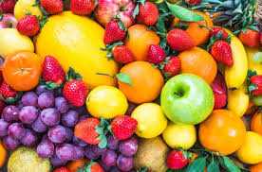
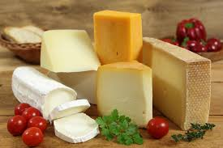


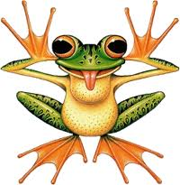
Fruits
Cheese
Vegetables

Slide 29

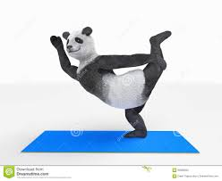


HOW TO KEEP YOUR TEETH IN GREAT SHAPE ?

Slide 30



Eat healthy foods
Stay away from sugary treats
Wear a mouth protector while playing sports

Slide 31




.
Floss everyday
Brush TWICE a day with fluoride toothpaste
Visit your dentist every 6 months

Slide 32

THANK YOU
FOR
BEING PART OF
BRUSH-A-MANIA
2024
.

Slide 33

THE END

